Slide 1

Back Up and Recovery
Sue Kayton
October 2015

Slide 2
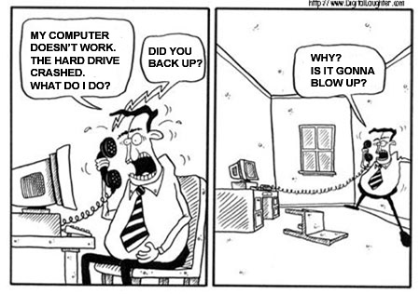

Slide 3


Slide 4
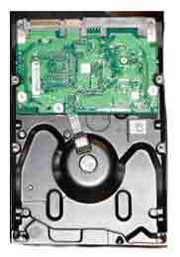

We have a fireproof safe
We had a fireproof safe

Slide 5


Where to back up
On site (in house or office)
Off site (in safe deposit box, neighbor)
Cloud

Slide 6



Cloud storage
6

Slide 7
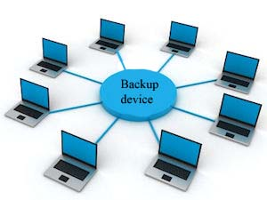

How to back up

Slide 8
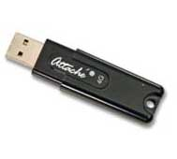
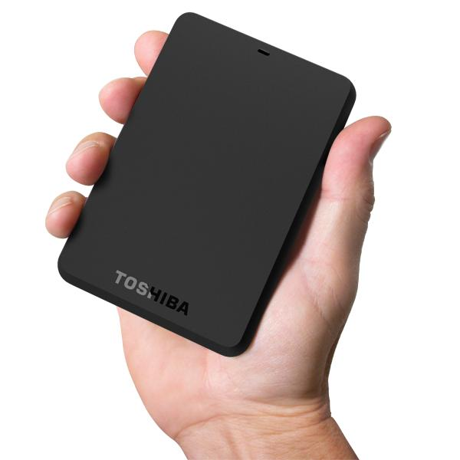
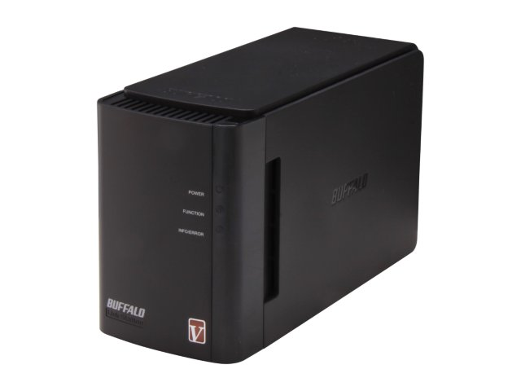
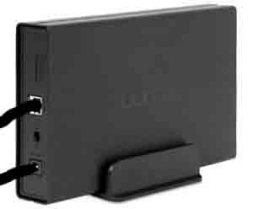
Back up hardware
  USB keychain drive
  External portable hard drive
  External hard drive
  Network attached storage (NAS)
  Windows desktop or server

Slide 9
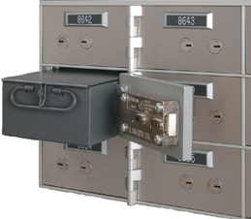
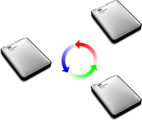
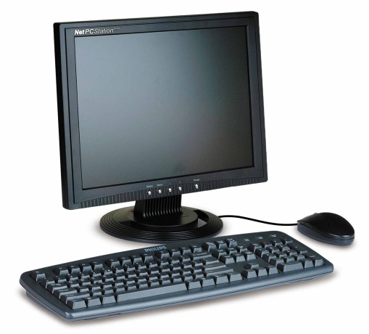

Rotate backup drives

Slide 10
RAID or NAS devices
  Redundant Array of Inexpensive Disks (RAID)
  Network Attached Storage (NAS) device
  Multiple hard drives protect against single disk failure
  Complex to install
  Requires software on client computers
  Data will be permanently lost if enclosure fails
  Enclosure failures are common
  Keep another copy of
  all data on NAS

Slide 11
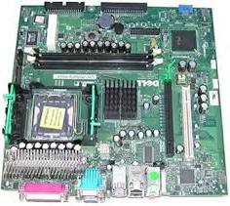
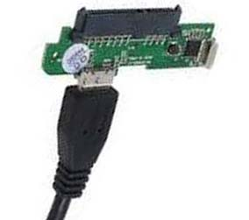
NAS vs. external hard drive

Slide 12
How often to back up
System back up once or twice a year, or when you install a major software package
Complete data back up once a month for home users, typically once a week for business.
Daily or hourly backup of active files for business
Continuous real-time cloud back up (i.e. Dropbox) for critical data

Slide 13




Automatic backup ?

Slide 14
Back up desktops and laptops
Data backup
Documents, favorites, bookmarks, pictures,
downloads, installers, Outlook, QuickBooks
GFI Backup software
System backup
Windows image backup (all or nothing)
Acronis image backup (flexible)

Slide 15
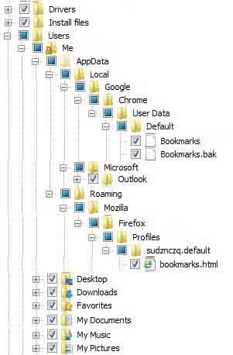
Back up data, bookmarks, favorites, pictures, music, installers, etc.

Slide 16

Outlook, Quicken, and QuickBooks
These files can get too big to back up or
open reliably
Archive or delete older items
Empty Deleted Items folder
Compact or purge Outlook
once a month

Slide 17
Passwords and usernames
Make a list of all usernames and passwords
  Computer login
  Email
  Wireless network
  Online accounts
Key employees or family members should have copy of list
Put copy in safe deposit box

Slide 18
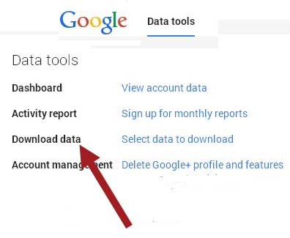
Other things to back up
Webmail (Gmail)
Gmail calendar
Gmail Contacts
Cell phone photos,
apps and files
Data on tablets and laptops

Slide 19


Slide 20
System recovery options
Roll back to factory as-shipped condition
  Need recovery DVDs or flash drive
Restore to Windows or Acronis system image
  Need Windows or Acronis boot/repair disk
Roll back Windows system files
  Seldom succeeds
Clean install of Windows or Mac OS
  Need all your install disks and install files

Slide 21
Data recovery
Recover data from last full data backup
Incremental data backup for files changed since last data backup
Super simple if all data is in the cloud.

Slide 22
Disaster recovery – without a backup
Sometimes you get lucky and can recover data for less than $200
Sometimes you need a clean room and $1,000+ to recover data
Sometimes data cannot be recovered at any price

Slide 23
Back Up and Recovery
Sue Kayton
October 2015

