Slide 1
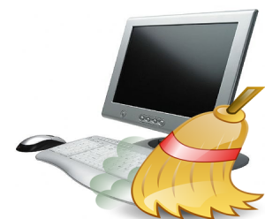
Keep Your Computer Clean
Sue Kayton
October 2015

Slide 2
Physical care of computer
Keep the computer physically clean
Install only the programs you need
Minimize the number of startup programs
Turn off the computer when not in use
Don’t yank or pull on cords

Slide 3
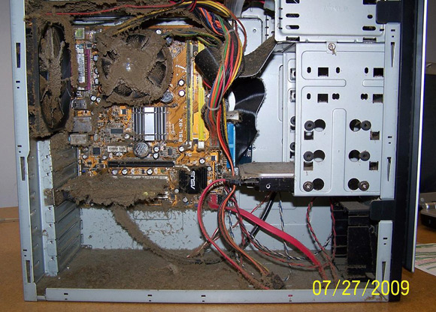

Slide 4
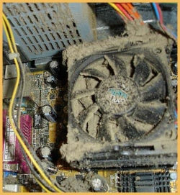

Slide 5

Clean your desktop twice a year
Unplug the power cord
Open the lid
Vacuum the insides and air holes
Using a clean, dry toothbrush, clean the fans and heat sink

Slide 6
Choosing Passwords
Don’t use dictionary words
Mix of letters, numbers and special characters
Some providers require at least one upper case and one lower case letter
Write them down! Write clearly
Distinguish number 1 from letter l
Distinguish letter O from number 0
Distinguish upper case from lower case

Slide 7
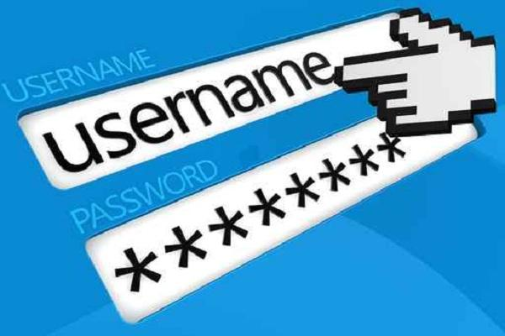
Password managers
Controversial but NOT recommended
Doesn’t protect against theft
Single weakest link
Not practical away from home
You can still forget your password
What’s the point?

Slide 8
Why is my computer so slow?
Why does it freeze?

Slide 9


Want a free yacht?

Slide 10
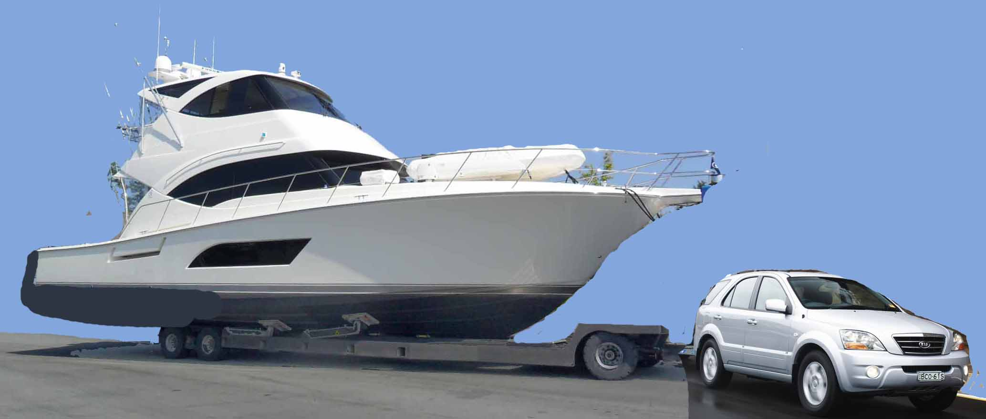
There’s a catch

Slide 11
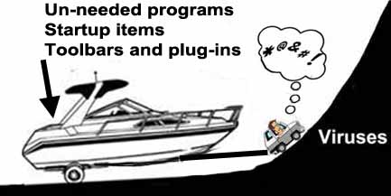

Slide 12

Computer too slow?
Virus
Hard drive too full
Downloading updates
Too many startup items
Delete temp files
Overheating due to dirt
Not enough memory

Slide 13
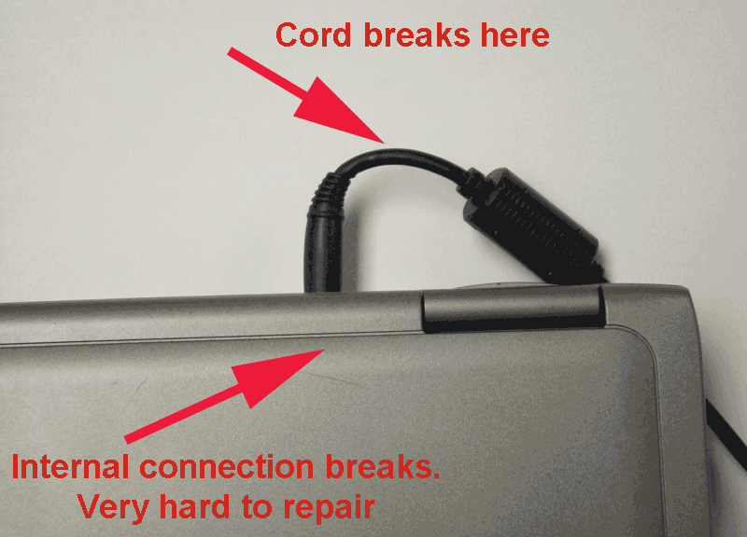
Don’t abuse your laptop!

Slide 14
Other laptop precautions
Turn off when not being used.
Prop up so air can circulate underneath
Don’t use on soft surface if it has bottom vent holes
Keep food and drink away
Remove CDs and DVDs from drive when not in use

Slide 15
Viruses and Malware

Slide 16
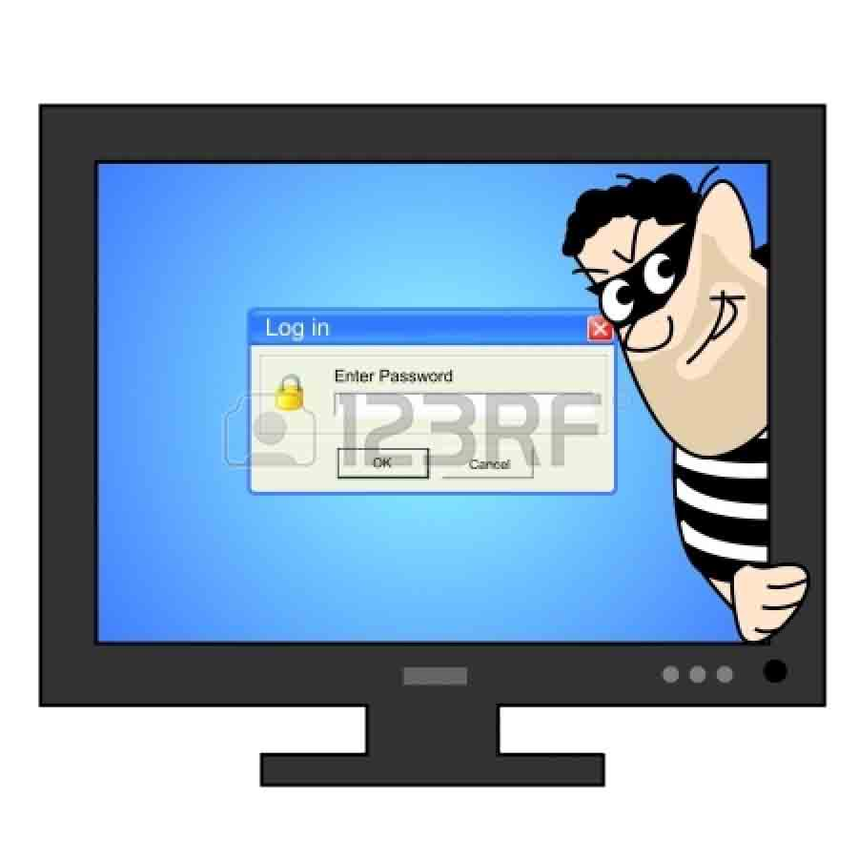

It can happen to
YOU

Slide 17
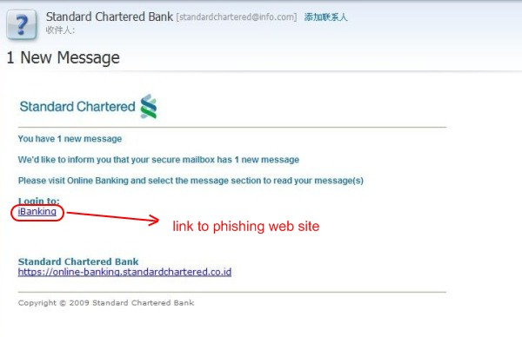
Be paranoid
Don’t click on banking or security links. Type in the address if you know it’s legit.
Make sure you are on the REAL site, not a mis-spelling or phishing or fake site

Slide 18
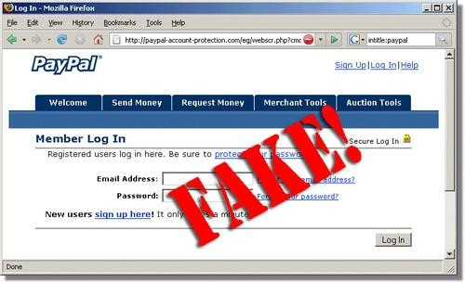

Slide 19



How to avoid viruses
Don’t download free music
Don’t download free pornography
Don’t visit questionable websites
Don’t open iffy attachments
Don’t let teenagers use your computer!

Slide 20
Real anti-virus programs
Recommended
  Norton Anti-Virus
  McAfee Anti-Virus Plus
  Kaspersky Anti-Virus
  Symantec Anti-Virus or Endpoint Protection
  AVG Anti-Virus Free 2014
  Microsoft Defender or Security Essentials
Not recommended
  Suites or full protection packages, AVG paid, Panda, Trend, Avira, Avast

Slide 21
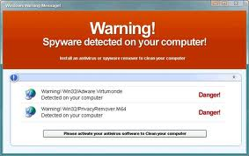
Fake security programs
Be paranoid!
Don’t be fooled by fake alerts
Don’t visit questionable websites

Slide 22
http://en.wikipedia.org/wiki/List_of_rogue_security_software
Advanced Cleaner
AKM Antivirus 2010 Pro
AlfaCleaner
Alpha AntiVirus
ANG Antivirus
Antimalware Doctor
AntiMalware
AntiSpyCheck
AntiSpyStorm
AntiSpyware 2009
Antispyware 2010
AntiSpyware Soft
Antivir Solution Pro
Antivirus Action
Antivirus 7 or Antivirus5
Antivirus 8
Antivirus IS
Antivirus Scan
Antivirus Soft
Antivirus Suite
Antivirus Studio 2010
Antivirus System PRO
AntiSpyware Bot
AntiSpywareExpert
AntiSpywareMaster
AntiSpywareSuite
AntiSpyware Shield
Antivermins
Antivirus 2008
Antivirus 2009, Anti Virus 2010
Antivirus XP 20100
Antivirus 2010
Antivirus 360
Antivirus Pro 2009
AntiVirus Gold or AntivirusGT
Antivirus Live,
Antivirus Master
Antivirus XP 2008
Antivirus Pro 20100
AV Security Suite
Avatod Antispyware 8.0
Awola
BestsellerAntivirus, Browser Defender
Blockzilla
ByteDefender
Cleanator

Slide 23
ContraVirus
Control Center
Cyber Security, Core Security
Data Protection
Defense Center0
Ultra Defragger
Vista Antimalware 2011
Win7 Antispyware 2011
Quick Defragmenter
Antivirus 8
Remove Palladium Pro
Remove Personal Internet Security 2011
Remove Memory Fixer
Remove HDD Fix
Remove Win Defrag0
Remove HDD Plus
Remove Hard Drive Diagnostic
Remove Disk Doctor
Remove Win HDD
Remove System Tool 2011
Remove Windows Scan
Remove Windows Utility Tool
Remove Antivirus .NET
Remove AVG Antivirus 2011
Remove Windows Shield Center
Desktop Security 2010
Digital Security
Disk Defrag
Doctor Antivirus
Doctor Antivirus 2008
DriveCleaner
Dr Guard
EasySpywareCleaner, EasyFix Tools
eco AntiVirus
Errorsafe, Error Expert
ErrorSmart, ErrorFix
Flu Shot
Green Antivirus 20090
HDD Rescue
IE Antivirus
IEDefender
InfeStop
Internet Antivirus
InstallShield
Internet Security 2010
KVMSecure
Live PC Care
Live Security Suite

Slide 24
MacSweeper
MalwareCrush
MalwareCore
MalwareAlarm
Malware Bell
Malware
Malware Defense
MS Antivirus Microsoft Anti Malware
MS AntiSpyware 2009
MaxAntiSpy
My Security Wall
My Security Engine
My Security Shield
Wireshark Antivirus
AV Antivirus Suite
PC Defender Antivirus
www2.Hard-Securityarmy.in
HDD Plus
Hard Drive Diagnostic
Disk Doctor
Win HDD
System Tool 2010
HDD Scan1
Internet Antivirus 2010
HDD Rescue
MxOne Antivirus
Netcom3 Cleaner
Paladin Antivirus
Navashield
PCSecureSystem
PC Antispy
PC AntiSpyWare 2010
PC Clean Pro
PC-Doctor
PC Scan and Sweep
PC Privacy Cleaner
PerfectCleaner
Perfect Defender
Perfect Optimizer
PersonalAntiSpy Free
Personal Antivirus
Personal Security
PAL Spyware Remover
PCPrivacy Tools
PC Antispyware
Protection Center
PSGuard
Privacy Center

Slide 25
Rapid AntiVirus
Real AntiVirus
RegAlive
Reggenie Antivirus
Registry Great
Registry Patrol
Registry Defender
Registry Winner
Reg tool
Safety Alerter
Safety Center
Security Center
SafetyKeeper
SaliarAR
SecureFighter
SecurePCCleaner
SecureVeteran
Security Master AV
Security Scan 2009
Security Tool
Security Toolbar
Security Suite Platinum
SiteAdware
Security Essentials 2010
Smart Engine
Smart Antivirus 2009
Smart HDD
Soft Soldier
SpyAxe
Spy Away
SpyCrush
Spydawn
SpyEraser
SpyGuarder
SpyHeal
SpyHeals
VirusHeal
SpyMarshal
Spylocked
SpySheriff
PestTrap
BraveSentry
SpyTrooper
SpySpotter
SpywareBot
SpywareSTOP
Spyware Cleaner
Spyware Blaster
SpywareGuard 2008
Spyware Protect 2009
SpywareQuake
SpywareSheriff
Spyware Stormer
Spyware X-terminator
Spy Tool
Spyware Striker Pro
Spyware Protect 2009
SpywareStrike
SpyRid
SpyWiper
SystemArmor
SysGuard
Sysinternals Antivirus
System Defragmenter
System Antivirus 2008
System Live Protect
SystemDoctor
Spyware Doctor
System Security
ThinkPoint

Slide 26

Parental control software
K-9 BlueCoat is free
  Control hours of internet use
  Control types of internet access
  www.k9webprotection.com

Slide 27
Keep Your Computer Clean
Sue Kayton
October 2015

