Slide 1
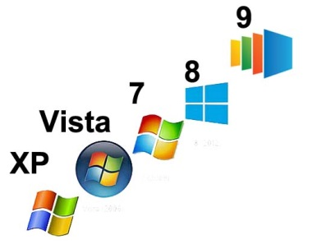
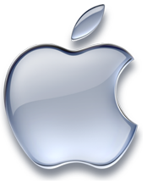
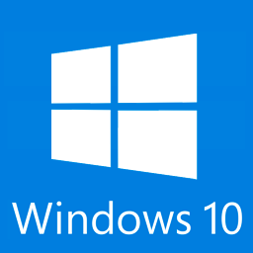
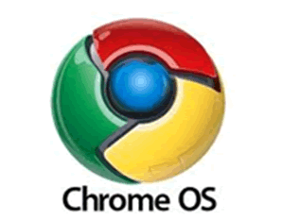
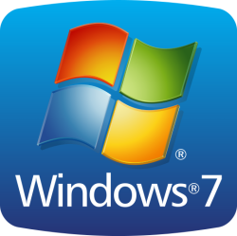

Operating systems

Slide 2
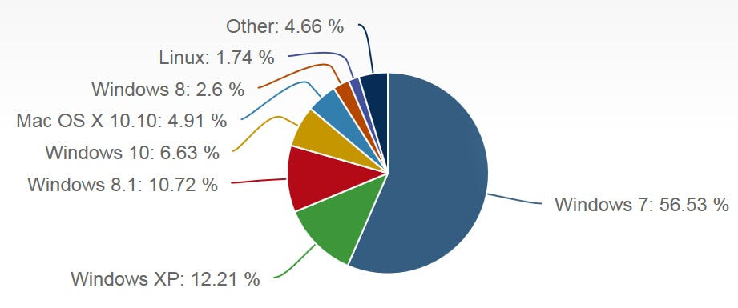
Desktop computers worldwide
As of October 2015
https://www.netmarketshare.com/operating-system-market-share.aspx?qprid=10&qpcustomd=0
2

Slide 3
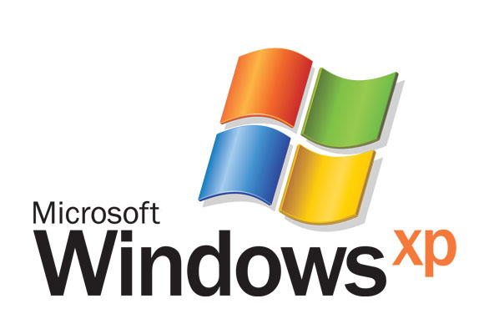
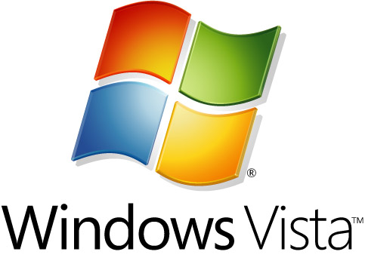
Still works OK
Designed to do WORK
Will be useful for another year or two
Use Firefox or Chrome for Internet
BACK UP your data before computer fails
May want to replace machine before it breaks

Slide 4
The most popular Windows version
Works great
Designed to do work and play
Will be useful for another 6 to 8 years
Compatible with most peripherals
No need to upgrade

Slide 5
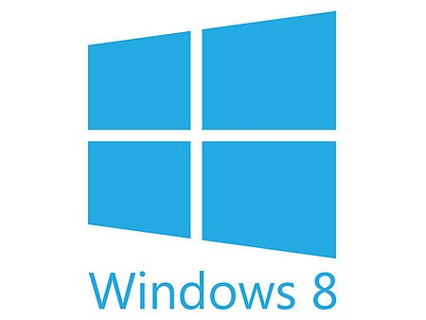
Major compatibility issues
OK for email, browsing, and watching video
Not OK for power users
Designed for PLAY, not work
A touch screen is NOT necessary
Windows 8.1 is still a problem

Slide 6
Minor compatibility issues
OK except for older software, cameras, scanners
Touch screen NOT needed or recommended
Upgrade free until July 26, 2016
Will be last version of Windows ever

Slide 7
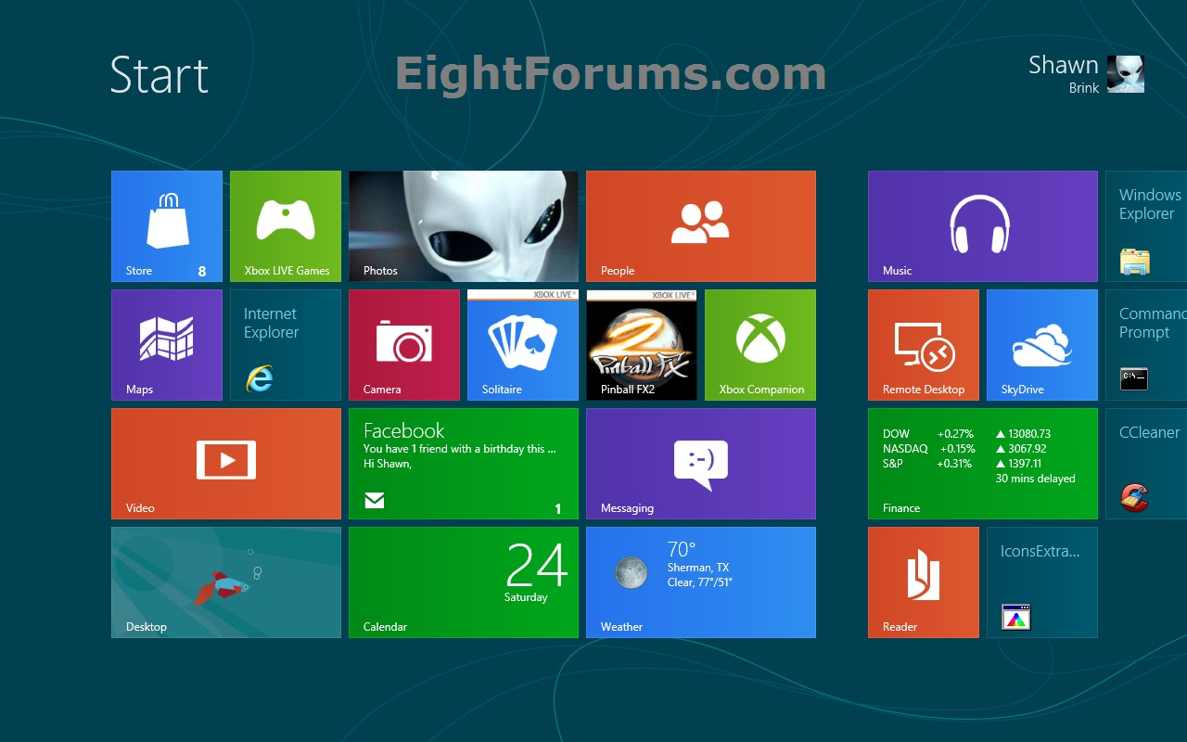
Windows 8 Modern mode (Tiles)

Slide 8
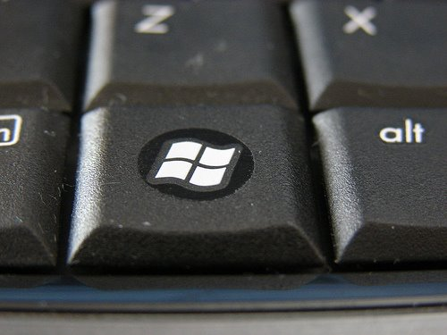
Windows 8 keyboard shortcuts
Alt-F4 to close window
Windows-P to change display
Windows (and type) to search
Windows key to toggle
between modes

Slide 9

Classic shell
Give you back the Start Menu
Allows you to boot to Windows 7 mode
(Windows 8.1 does this automatically)
Free download from www.ninite.com

Slide 10
Major compatibility issues
Most software won’t run
Many websites won’t work
Planned obsolescence in 4-5 years
2 - 3 times the price of Windows machines

Slide 11
Inexpensive basic system for casual users
Browse the internet, emails, photos
Looks like a laptop, acts like a smart phone without the phone calls
Uses apps instead of programs
More apps available every day

Slide 12
Used primarily by geeks and hackers
Major compatibility issues
Very little software available
Many websites don’t work
For people who want to write their own programs

Slide 13
Operating systems

