Slide 1

Protect yourself from scams
Sue Kayton
February 2026

Slide 2
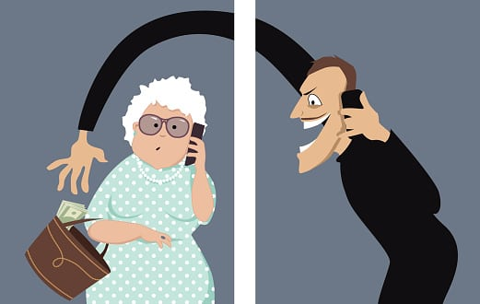

Slide 3
Common types of scams
  Phone calls
  Emails
  Computer pop-ups
  Fake online merchants
  Text messages
  Letters in the mail
  Romance and friendship scams

Slide 4
Phone calls

Slide 5

Scam phone calls
HANG UP immediately if you get a phone call from a someone claiming to be:
Apple, Microsoft, Dell, HP or
any computer company
The government - Medicare,
the IRS or Social Security
A bank or investment advisor (unless it is someone you know personally)

Slide 6

Scam phone calls
  Phone calls from someone pretending to be a friend or relative in distress are almost always scams.
  Ask them a question to prove their identity.

Slide 7

AI voices
Computer-generated voices can imitate real people’s voices
Do not volunteer the child’s/grandchild’s name.
If it sounds suspicious, ask questions that only the real person could answer

Slide 8
Scam phone calls
  Hang up immediately.
  Do not talk to them.
  Do not follow their instructions.
  If you think it might be legit, call the company’s real phone number

Slide 9
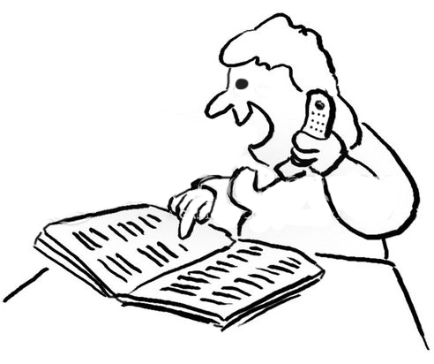
If you think the call is legit
Hang up.
Call the company and ask them if they tried to call you.
Look up the phone number in
your paper records.
DO NOT call a phone number
that you find on the internet.

Slide 10
Scam emails

Slide 11
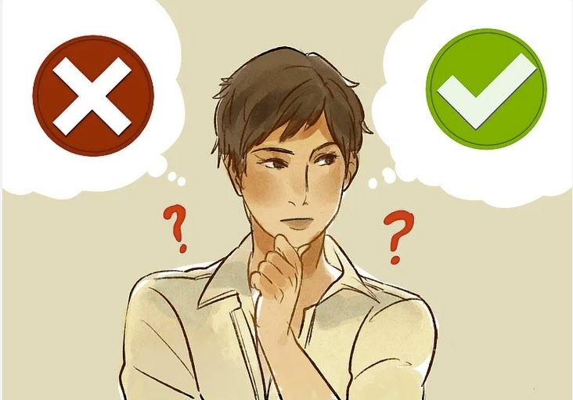
Stop and think.

Slide 12
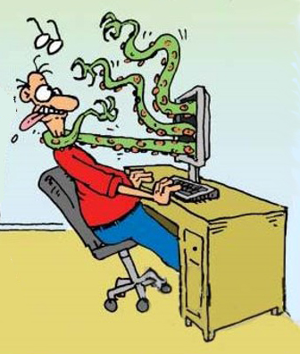

Slide 13
Scam email tactics
  Scary – your account will be deleted, you owe money, or your computer is infected
  Unexpected invitation
  Asking for help – buy gift cards or they need money
  Package delivery

Slide 14
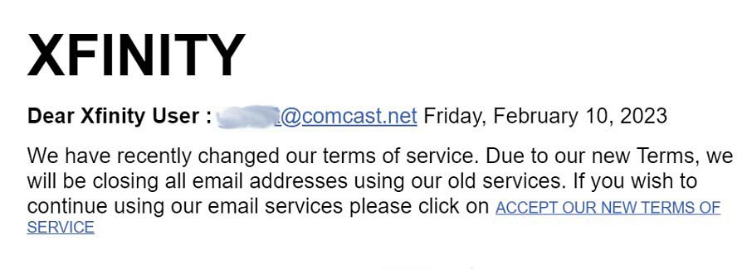
Scary emails

Slide 15
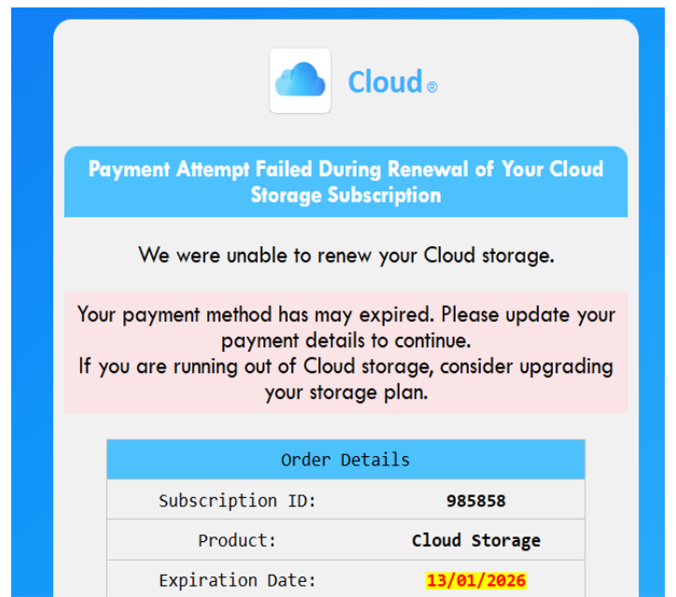

Slide 16
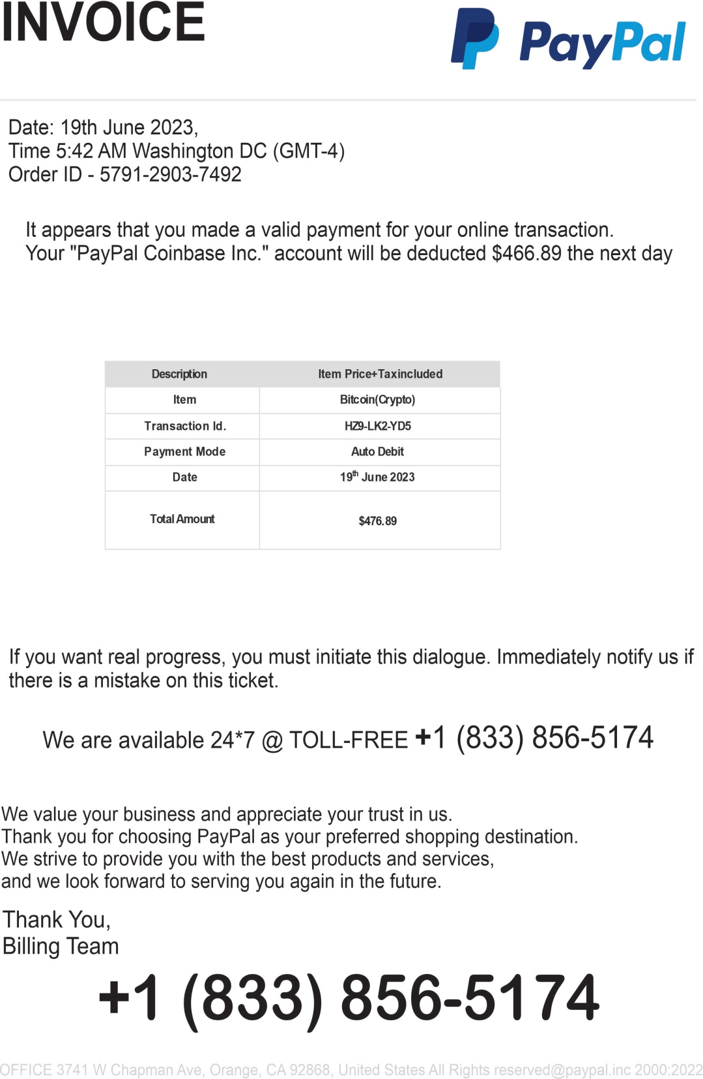

Slide 17
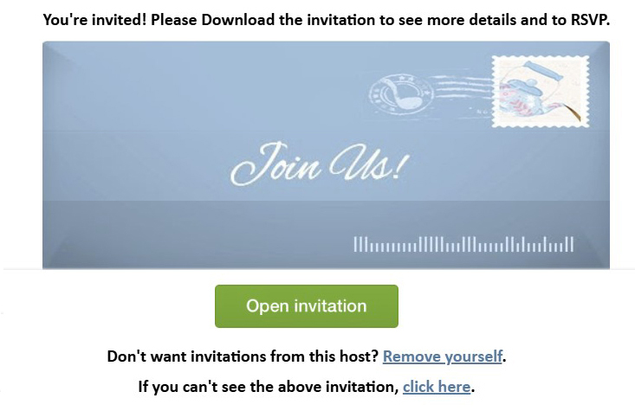

Slide 18
Scam emails
  If it looks strange or suspicious, or says they want you to do “a small favor,” it’s a scam.
  Do not reply.
  Do not follow the instructions.
  Delete it.

Slide 19
Scam emails
  If it claims that you have a virus or infection on your computer, it’s a scam.
  Most messages claiming to be from FedEx or UPS are scams.
  Do NOT follow the instructions.
  Delete the email.

Slide 20
Beware!
  NEVER buy a gift card, BitCoin, or cryptocurrency if they ask
  NEVER give out your passwords
  NEVER let them remote access your computer

Slide 21
Scam computer pop-ups

Slide 22
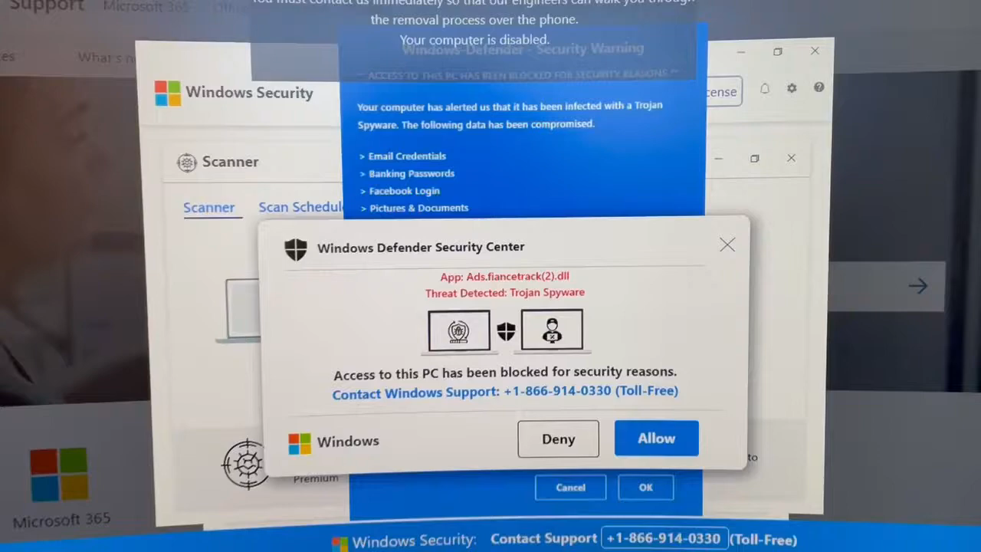
www.youtube.com/watch?v=KgEx-0xt-WA

Slide 23
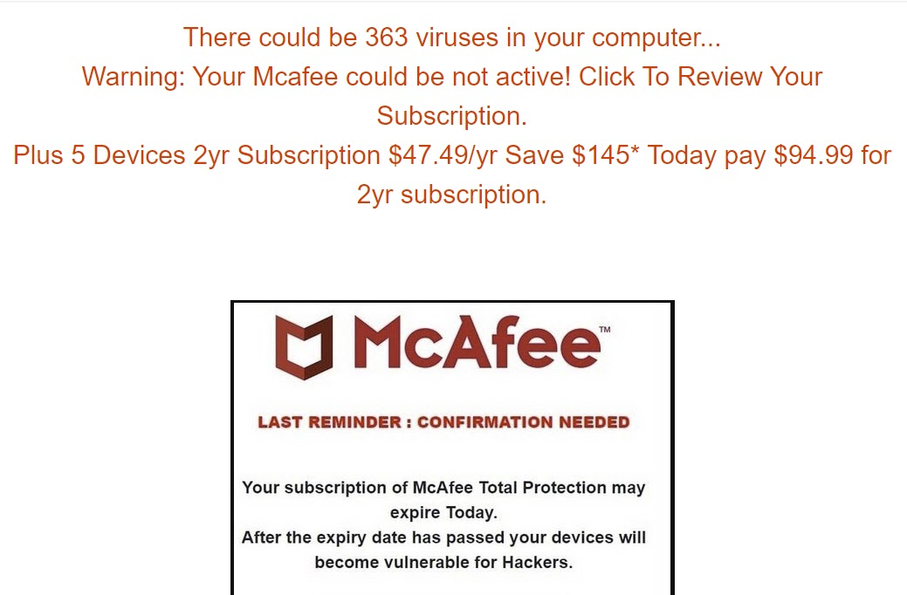
Scam computer pop-ups

Slide 24
Fake or malicious online merchants

Slide 25
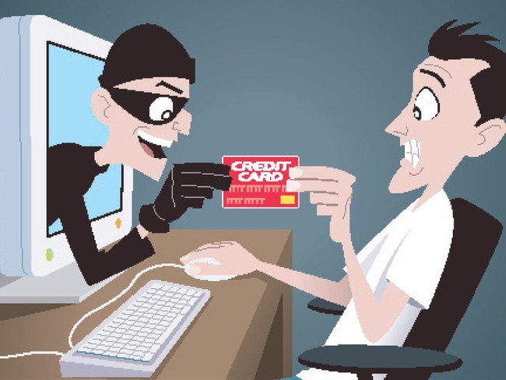

Slide 26
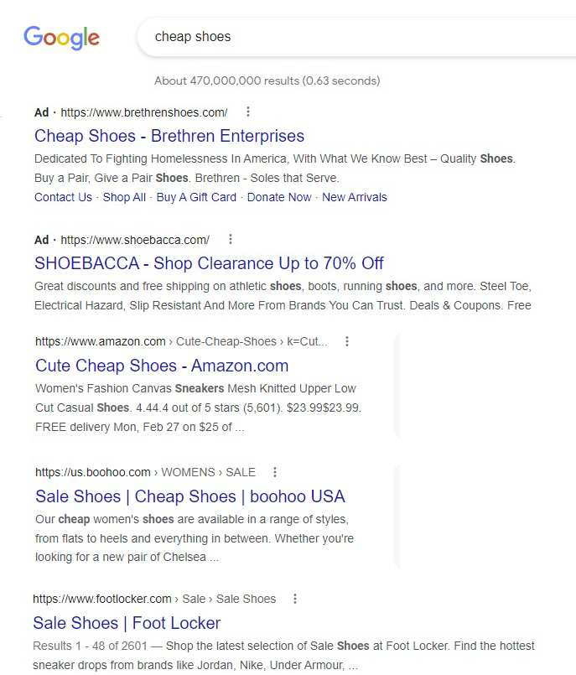



Slide 27
Scam text messages

Slide 28
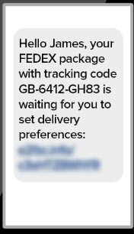
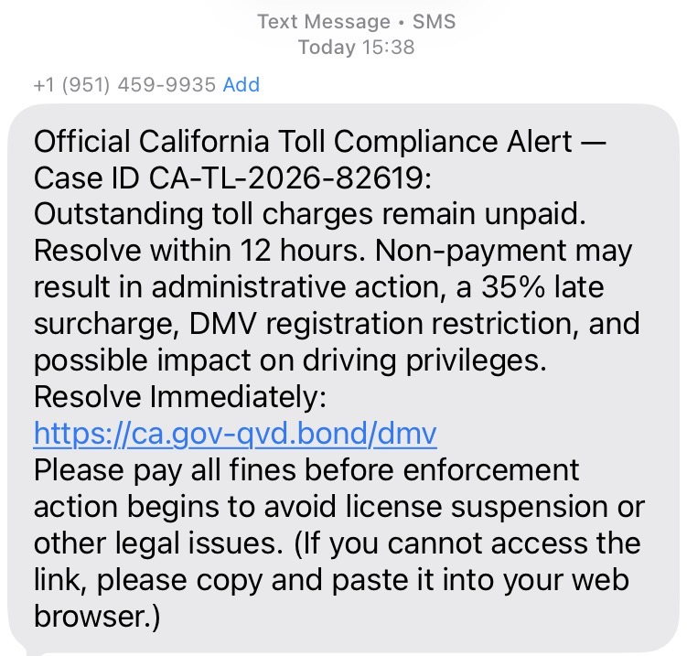
Scam text messages

Slide 29
Scam letters in the mail

Slide 30
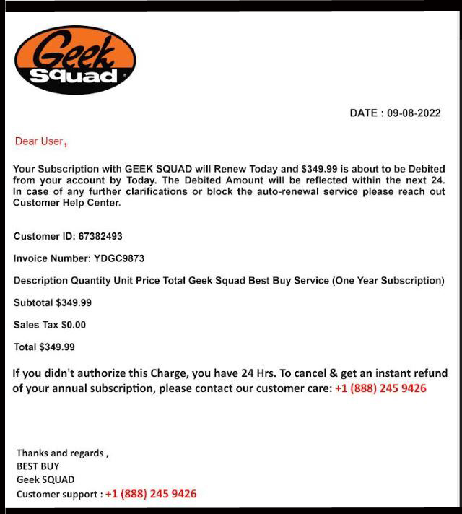
Scam letters

Slide 31

If your computer is infected
  Turn off the computer immediately
  If the mouse doesn’t work, push and hold the power button for 30 seconds
  If it still doesn’t turn off,
  unplug it

Slide 32
Stolen phones or computers
  NEVER save a banking password on your phone or computer
  Type in the password each time
  If someone steals your phone or computer, you don’t want them to have access to your bank.
  https://www.youtube.com/watch?v=QUYODQB_2wQ

Slide 33
What else can I do?
Set up two-factor authentication or a passkey
  Sends a text message to your cell phone to confirm your identity
Freeze your credit
  Hackers can’t open new credit cards in your name
Set up fraud alerts on your credit cards
  Receive an alert for unusual charges

Slide 34
Freeze your credit
Set up accounts and freeze your credit at the Big Three credit agencies
EquiFax
https://www.equifax.com/personal/credit-report-services/credit-freeze/
TransUnion
https://www.transunion.com/credit-freeze
Experian
https://www.experian.com/help/credit-freeze/

Slide 35
Credit card fraud alert
Call the phone number printed on your credit card and tell them that you want to be notified of possible frauds.
Tell them to notify you by a telephone call and make sure they have the correct telephone number listed.

Slide 36

Romance and friendship scams

Slide 37

Romance and friendship scams
A stranger calls you
They gradually gain your trust
Then they empty your bank accounts
Be suspicious of
strangers

Slide 38


  Learn more about scams
  www.aarp.org/money/scams-fraud
  The Washington Post has an excellent article about IRS phone scams www.suekayton.com/IRSscam_call.pdf

Slide 39

For more information
Contact Sue Kayton
The Computer Doctor
kayton@alum.mit.edu
(650) 853-1711 landline
(650) 740-6774 text
Download this presentation
In PowerPoint format
In PDF format

Slide 40

Get even with scammers
Enjoy these fun videos made by Mark Rober
Locating (and arresting) scammers
www.youtube.com/watch?v=VrKW58MS12g
Taking revenge on them.
www.youtube.com/watch?v=xsLJZyih3Ac

Slide 41
Stop and think.

Slide 42
Protect yourself from scams
Sue Kayton
February 2026

