Slide 1

Security and privacy
Sue Kayton
February 2023

Slide 2
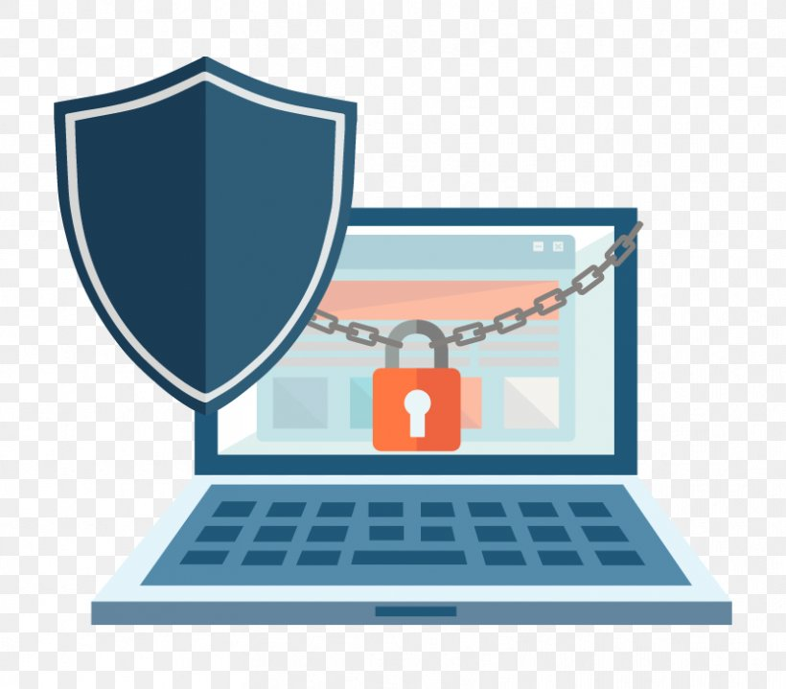

Slide 3
Types of security
INFECTION
  Be careful where you click!
  Viruses, malicious programs and other malware
SNOOPING
  Don’t use open WiFi networks
PASSWORDS
  Keep them safe
  Don’t re-use the same password
FILES AND DATA
  Back them up

Slide 4
Snooping or outside attack

Slide 5
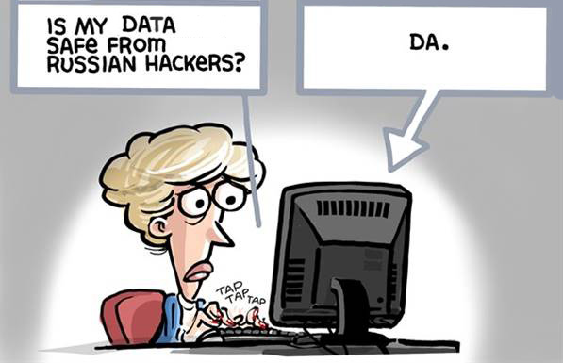

Slide 6
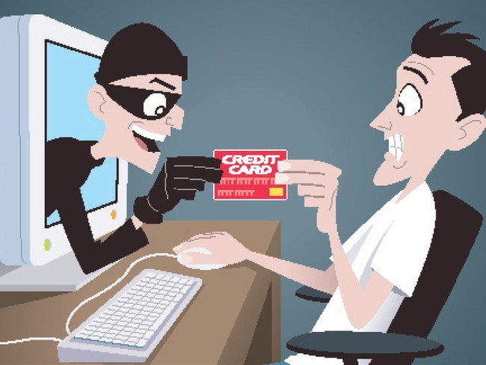

Slide 7
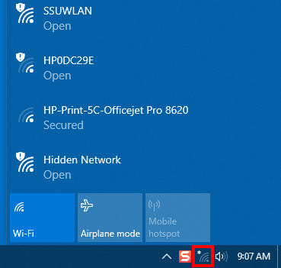
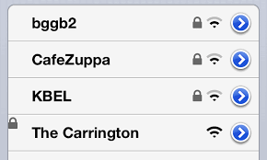
Open or secure WiFi?

Slide 8
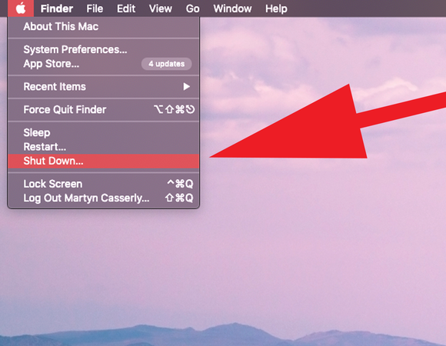
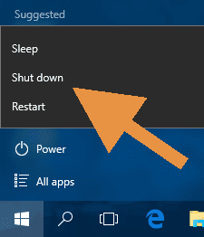
Turn your computer OFF when not in use

Slide 9
Infection

Slide 10
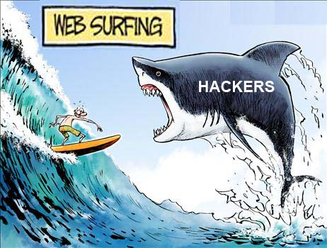

Slide 11
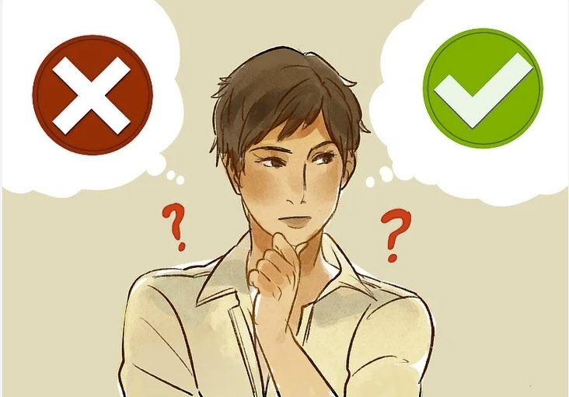
Stop and look.
Be vigilant.

Slide 12
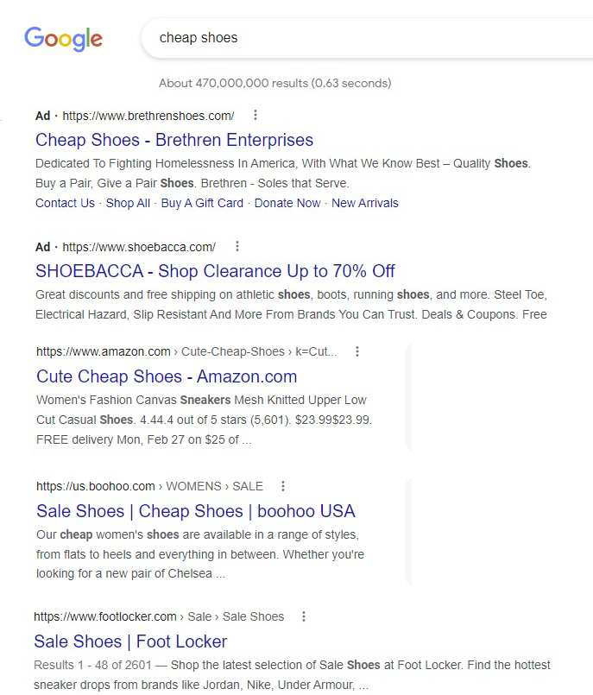

Slide 13
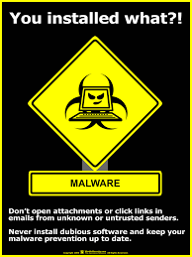

Slide 14
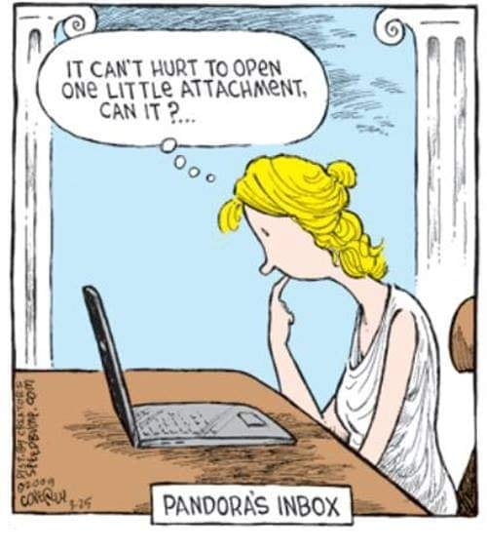




Slide 15
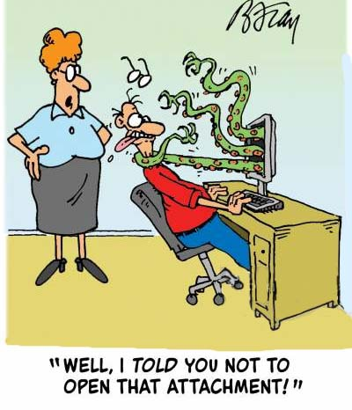

Slide 16
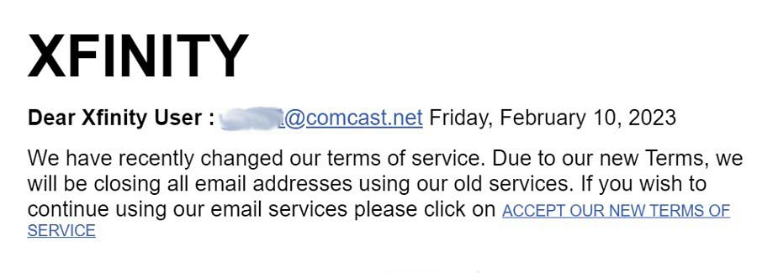
Phishing emails

Slide 17
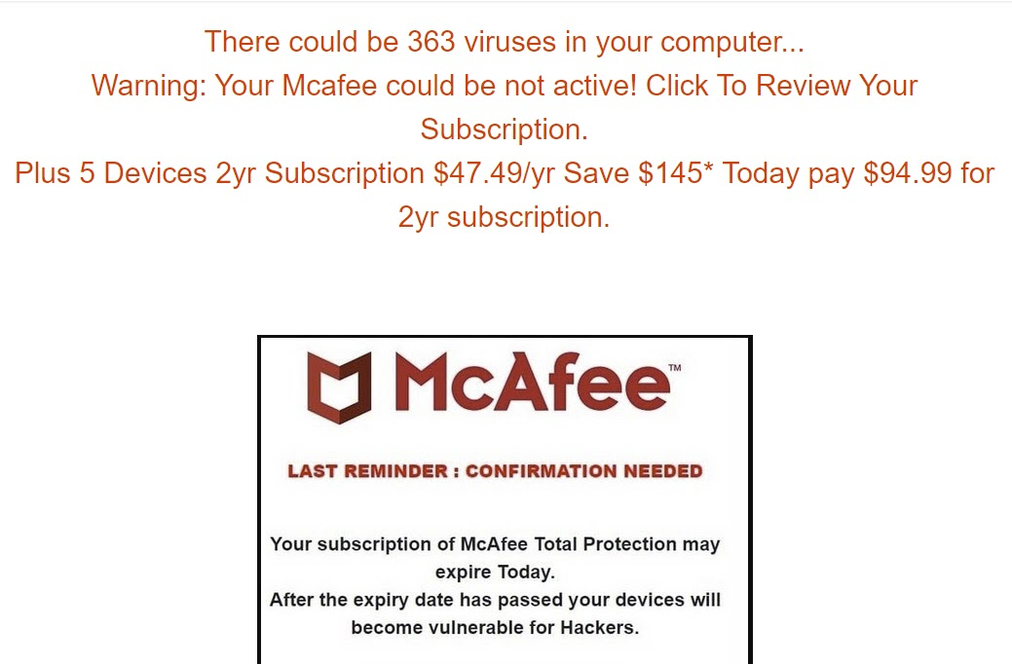

Slide 18
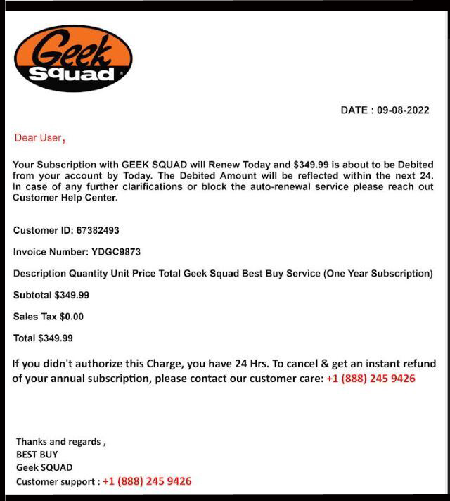
Scam letters

Slide 19

Scam phone calls
HANG UP immediately if you get a phone call from a scammer pretending to be:
Microsoft
Apple
The IRS
Social Security
Any computer company
Anything about computer security

Slide 20



Security Add-ons for Browser
HTTPS Everywhere (Chrome/Firefox)
  https://www.eff.org/https-everywhere
Privacy Badger (Chrome/Firefox)
  https://www.eff.org/privacybadger
DuckDuckGo search (all browsers)
  https://duckduckgo.com

Slide 21
Passwords

Slide 22
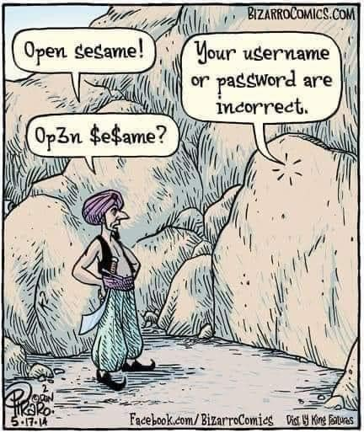

Slide 23
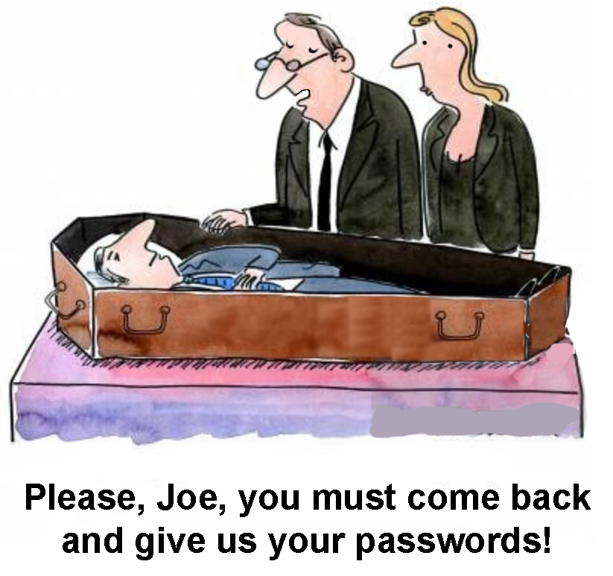

Slide 24
Password list
Include all usernames and passwords
Include unlock codes for phones and tablets
Make sure it’s legible
Give a copy to trusted friend, family member, or your lawyer
Update as needed

Slide 25
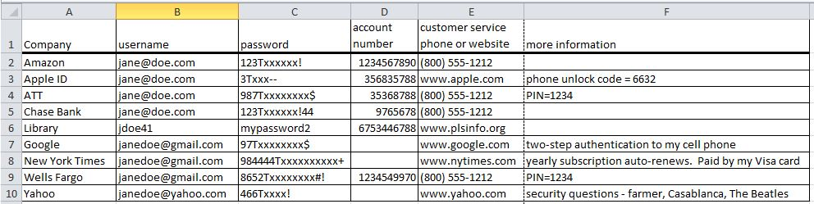
Sample password list

Slide 26
Storing data safely

Slide 27


Slide 28
Where to back up
On site (in your residence or office)
Off site (in safe deposit box, neighbor)
In the cloud (recommended)

Slide 29

What to back up
Contact list from phone
Documents
Pictures on phone
Pictures on computer
Anything else important

Slide 30




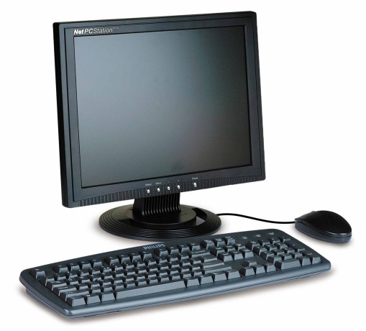
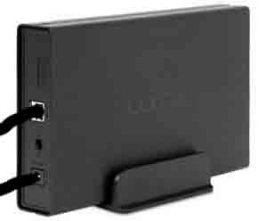
Automatic backup to the cloud

Slide 31




Google Drive (Google One)
Dropbox
Microsoft OneDrive
(included with Office 365)
iCloud
(not recommended for data)

Slide 32
Back up other important information
Location of financial accounts
Name of lawyer and accountant
Location of will, trust and other papers
Numerous other items
Use this handy template
https://tinyurl.com/bdeck8u4
Send to family member, lawyer, or trusted friend

Slide 33
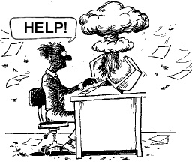

Slide 34
For more information
Read the Backup Bible
www.suekayton.com/backupbible.htm
Contact Sue Kayton
The Computer Doctor
kayton@alum.mit.edu
(650) 853-1711
Download this presentation
In PPT format https://tinyurl.com/3p3kkvbv
In PDF format https://tinyurl.com/6p9cp47y

Slide 35
Security and privacy
Sue Kayton
February 2023

