Slide 1

Security and privacy
Sue Kayton
June 2023

Slide 2
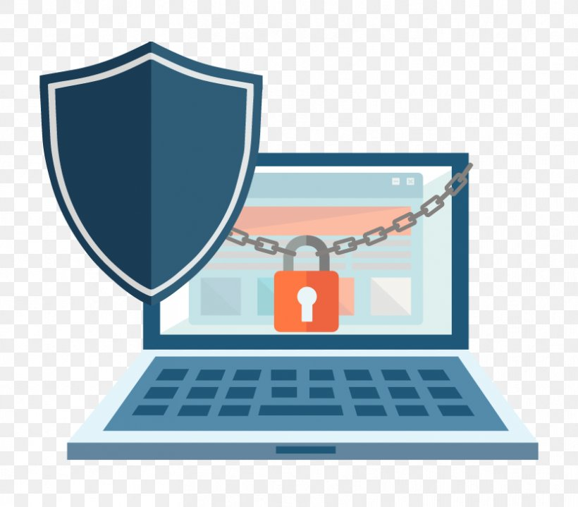

Slide 3
Types of security
INFECTION
  Be careful where you click!
  Viruses, malicious programs and other malware
PASSWORDS
  Keep them safe
  Don’t re-use the same password
FILES AND DATA
  Back them up
SNOOPING
  Avoid using open WiFi networks

Slide 4
Infection

Slide 5
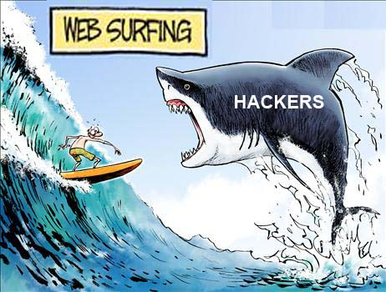

Slide 6
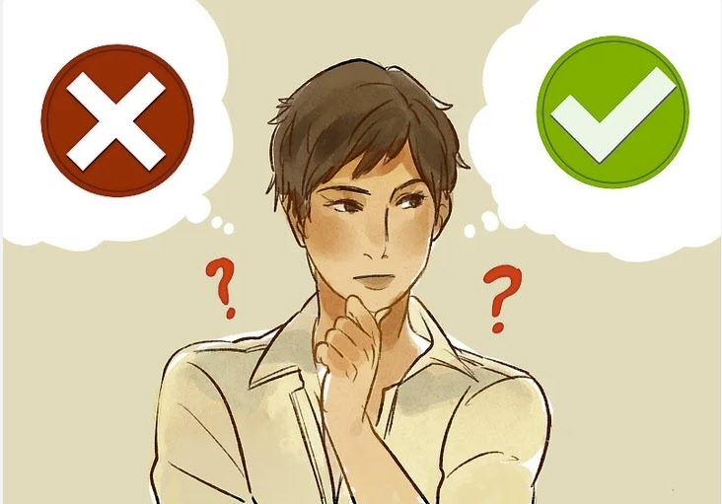
Stop and look.
Be vigilant.

Slide 7
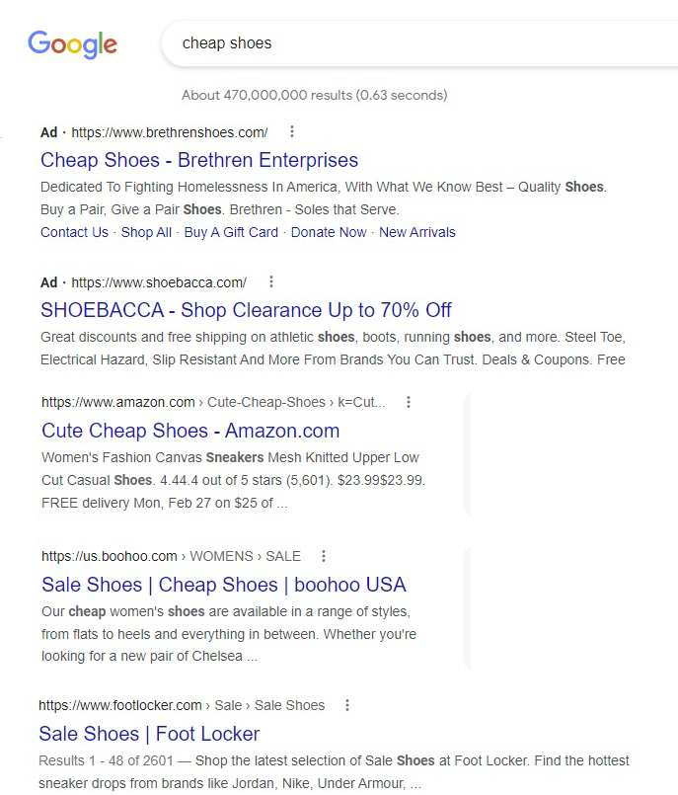



Slide 8
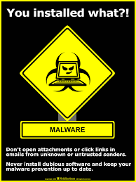

Slide 9
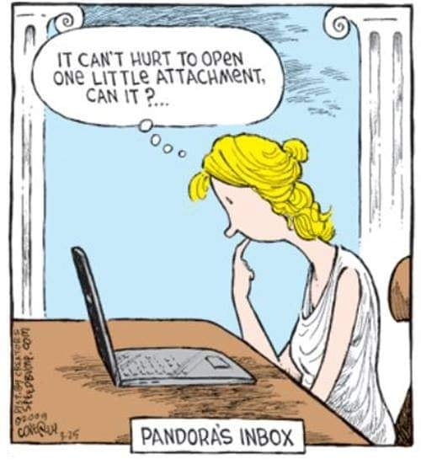




Slide 10
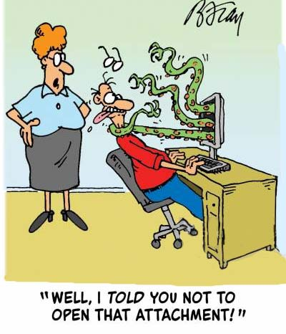

Slide 11
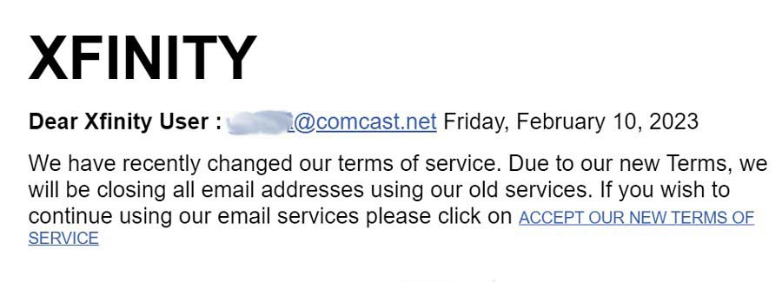
Scam (phishing) emails

Slide 12
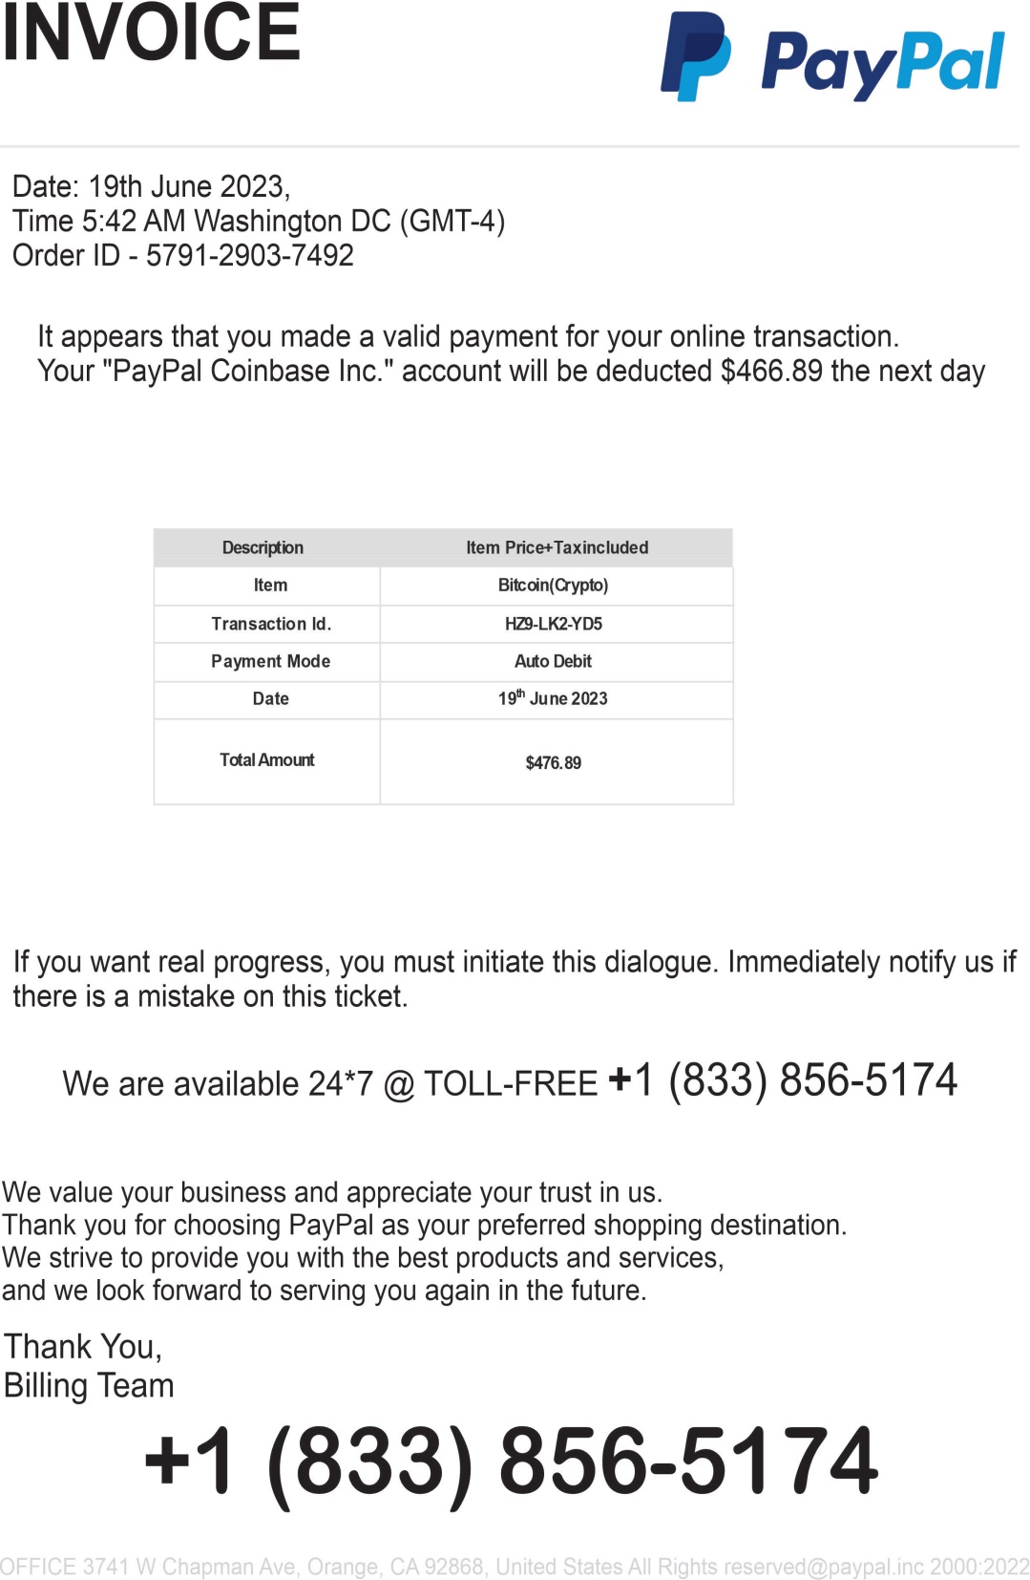

Slide 13
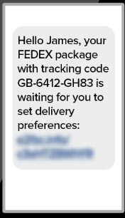
Scam text messages

Slide 14
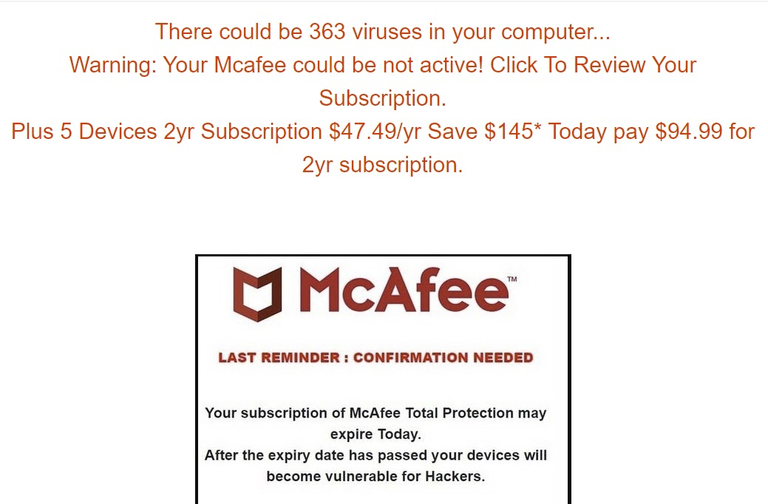
Scam computer pop-ups

Slide 15
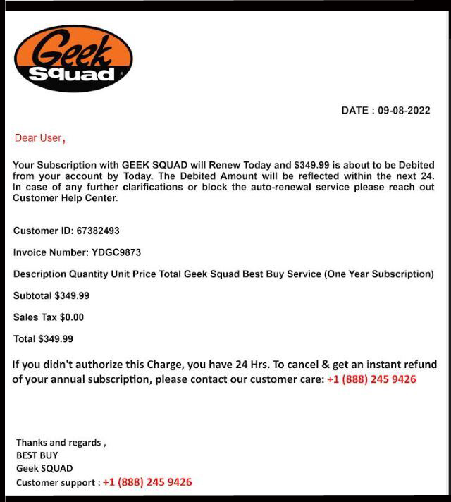
Scam letters

Slide 16

Scam phone calls
HANG UP immediately if you get a phone call from a scammer pretending to be:
Microsoft
Apple
The IRS
Social Security
Any computer company
Anything about your computer

Slide 17


Security features for browser
Enable HTTPS by default in your browser
  https://www.eff.org/https-everywhere/set-https-default-your-browser
Privacy Badger (Chrome/Firefox)
  https://www.eff.org/privacybadger
DuckDuckGo search (all browsers)
  https://duckduckgo.com

Slide 18
Anti-virus programs
Not very useful
Slow down your computer
Windows has built-in Windows Defender
McAfee WebAdvisor helps block nasty websites https://www.mcafee.com/en-us/safe-browser/mcafee-webadvisor.html

Slide 19
Passwords

Slide 20
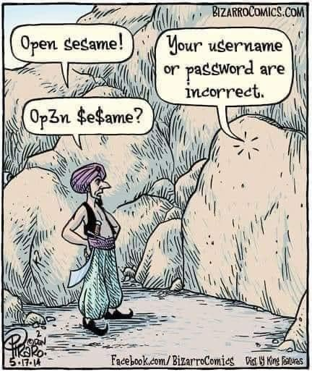

Slide 21
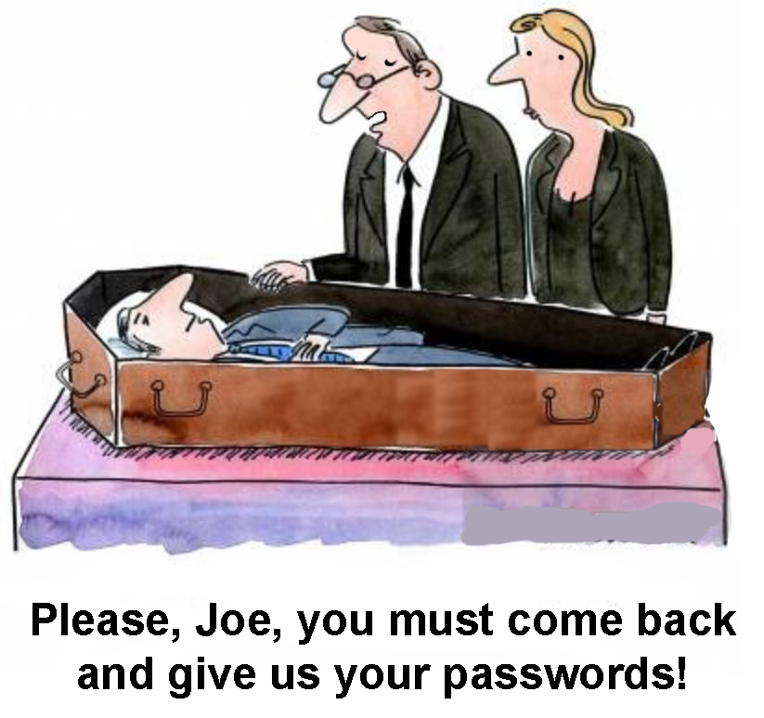

Slide 22
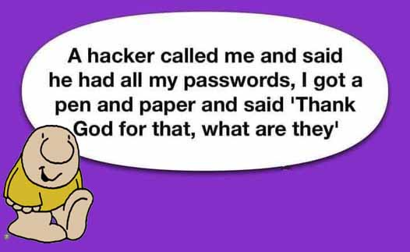

Slide 23
Password list
Include all usernames and passwords
Include unlock codes for phones and tablets
Make sure it’s legible
Give a copy to trusted friend, family member, or your lawyer
Update as needed

Slide 24
Is it safe to keep your password list on your computer or cell phone?
YES. But….
Don’t call the file “Passwords.”
Use password protection (Excel), or encryption (Google Sheets), or use a code to conceal the contents
Write down the file name, password, encryption key or decoding method, and give a copy to a trusted friend or family member.

Slide 25
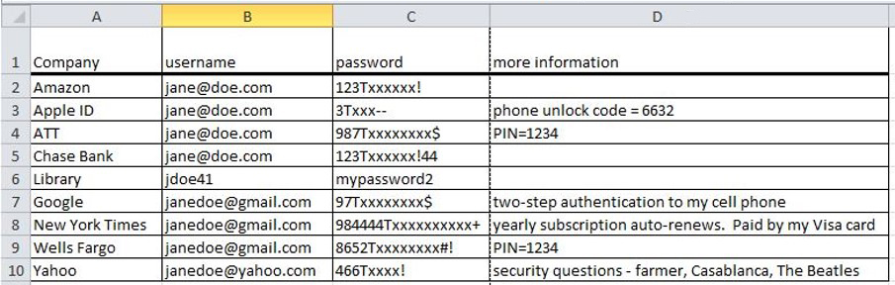
Sample password list

Slide 26
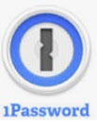






Password managers
NOT recommended
LastPass, DashLane, OnePass, many other companies
A rogue employee can expose all your passwords and empty all your bank accounts

Slide 27
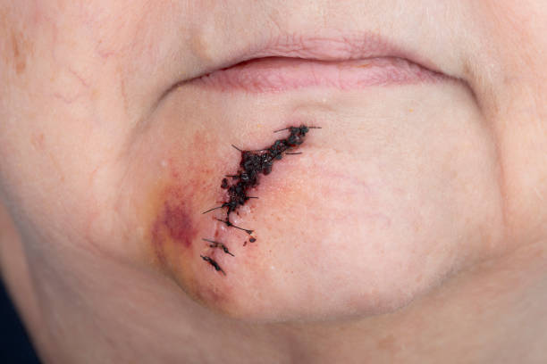
Facial recognition
If you use facial recognition to log in, there is still a password for the account. WRITE DOWN the account password so you can log in, even if your facial features change

Slide 28
Storing data safely

Slide 29


Slide 30
Where to back up
On site (in your residence or office)
Off site (in safe deposit box, give hardware to a friend or family member)
In the cloud (strongly recommended) with Google Drive, DropBox, or OneDrive

Slide 31
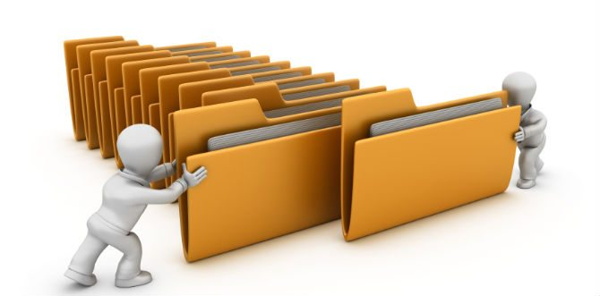
What to back up
Contact list from phone
Documents
Pictures on phone
Pictures on computer
Password list (including phone unlock code)
Anything else important

Slide 32


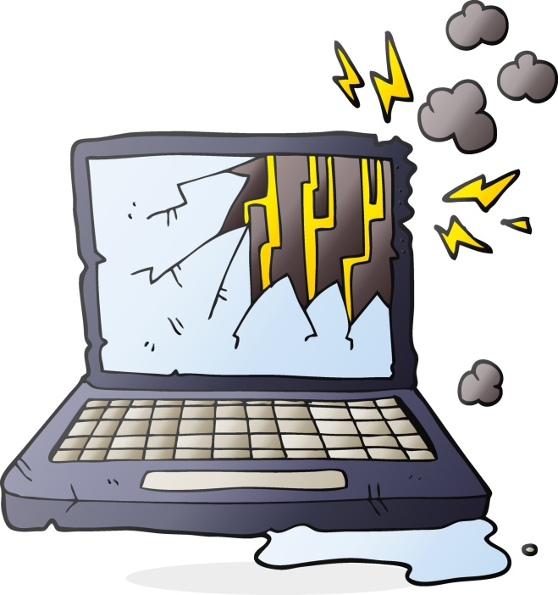
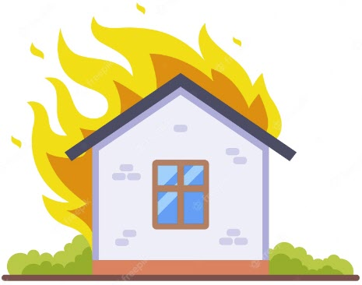

Why back up automatically
to the cloud?

Slide 33




Google Drive
Dropbox
Microsoft OneDrive
(included with Office 365)
iCloud
(not recommended for data)

Slide 34
Automatic backup-
common features
Back up, sync, selective sync
Roll back to previous versions
Free storage, pay for more if needed
No hassle

Slide 35
Google Drive
Integrates with Google Docs
World’s most popular automatic backup
15 GB for free, pay for more

Slide 36
Dropbox
Back up or sync
2 GB for free, pay for more
Efficient code does not slow computer down too much

Slide 37
Microsoft OneDrive
Included with Office 365 subscription (1000 GB storage)
5 GB for free or pay for more
Integrates with Microsoft Office
Changes your computer file structure

Slide 38
iCloud
Cannot restore individual folders
Delay of about 3 days to recover folders
15 GB for free, pay for more
Changes your computer file structure
Integrates with iPhone and Mac computers

Slide 39
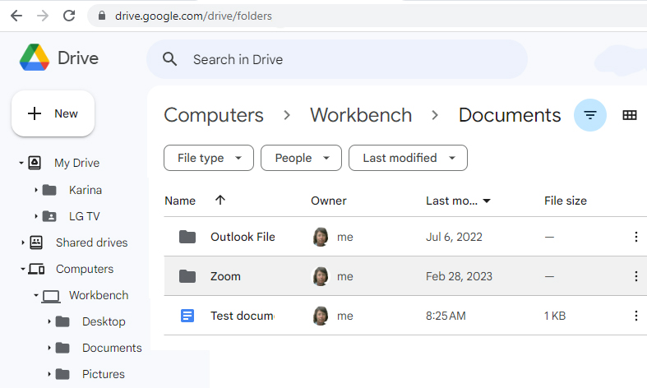

Slide 40
Back up other important information
Location of financial accounts
Name of lawyer, accountant, dentist and doctors
Location of will, trust and other papers
Numerous other items
Use this handy template
https://tinyurl.com/bdeck8u4
Send to family, lawyer, or trusted friend

Slide 41
Snooping or outside attack

Slide 42
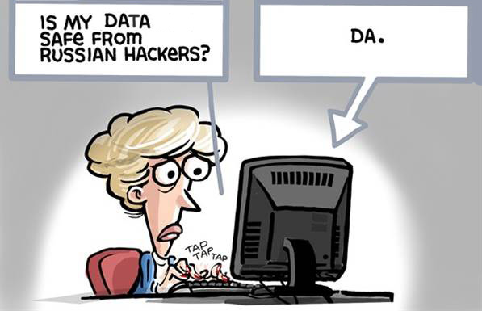

Slide 43
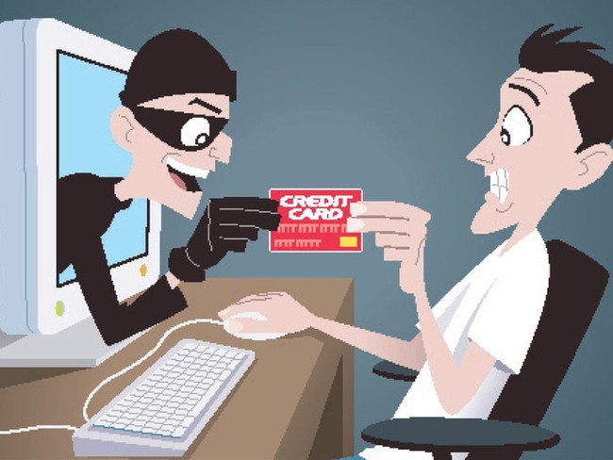

Slide 44
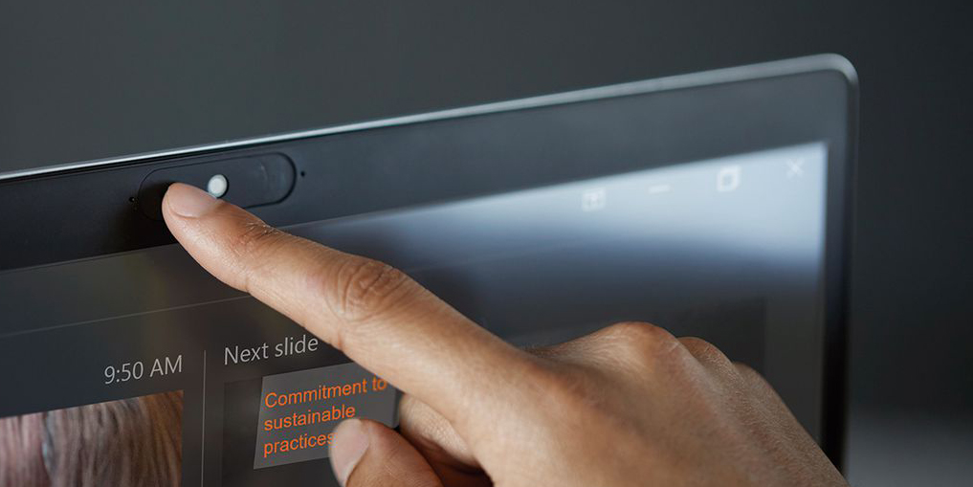
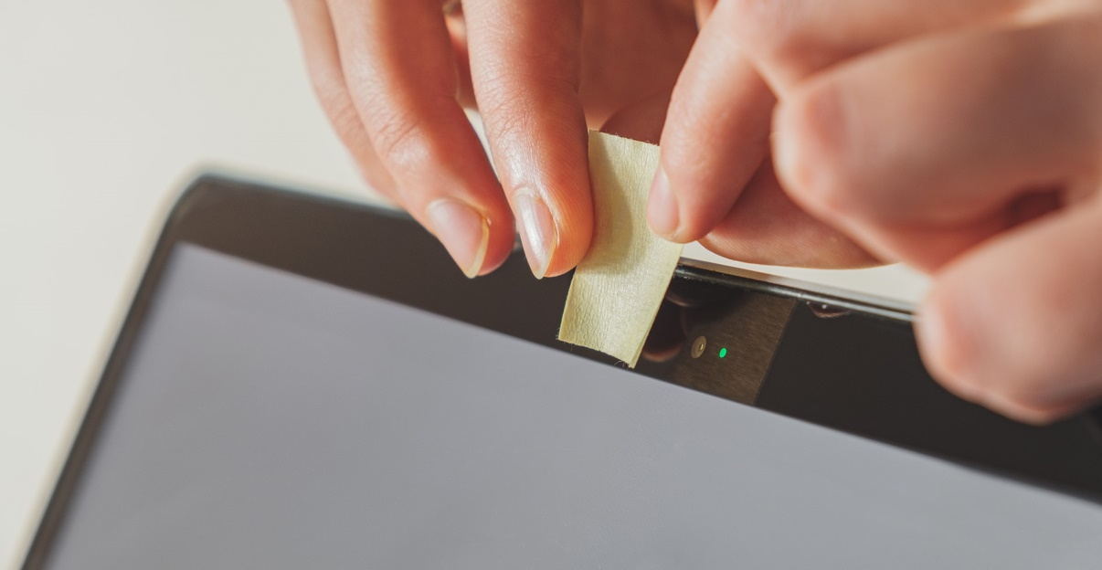
Cover your webcam when not in use

Slide 45
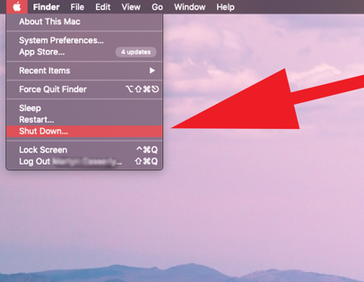
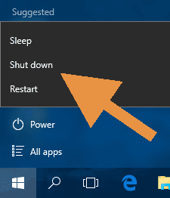
Turn your computer OFF when not in use

Slide 46
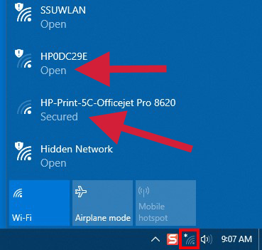
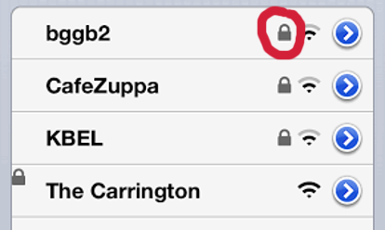
Is this WiFi secure?

Slide 47
Using unsecured WiFi
(such as SPVWIFI)
Don’t contact your bank or brokerage account, or do financial transactions. This includes online shopping like Amazon.
If you check your email, change the password when you get home
It’s OK to upload vacation photos via unsecured WiFi

Slide 48
Instead of using unsecured WiFi, use your cell phone as a WiFi hotspot. Cell phone service is encrypted and secure.
Unless you have an unlimited data plan, don’t use the cell phone hot spot for movies, video, or TV shows.

Slide 49
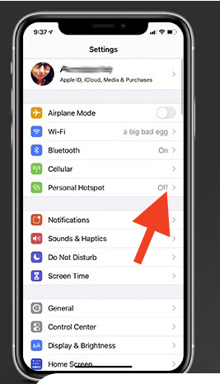
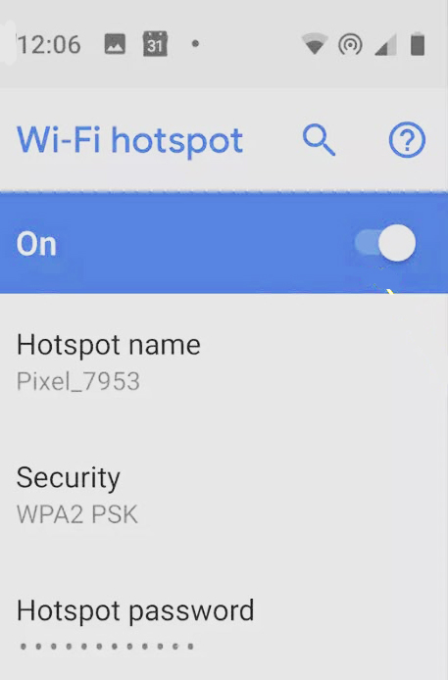
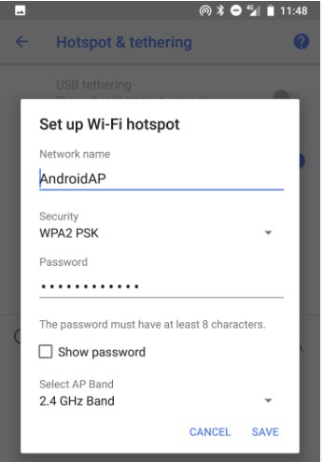
Secure WiFi anywhere turn on your cell phone hotspot

Slide 50
VPN – Virtual Private Network
Some people use a VPN to safely use an unsecured WiFi network. I don’t recommend this.
You can read more about VPNs on Tom’s Guide. https://www.tomsguide.com/best-picks/best-free-vpn

Slide 51
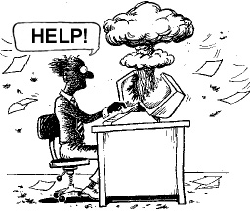

Slide 52
For more information
Read the Backup Bible
www.suekayton.com/backupbible.htm
Contact Sue Kayton
The Computer Doctor
kayton@alum.mit.edu
(650) 853-1711
Download this presentation
In PPT format https://tinyurl.com/khc2pskj
In PDF format https://tinyurl.com/349v3yb6

Slide 53
Security and privacy
Sue Kayton
June 2023

