Slide 1
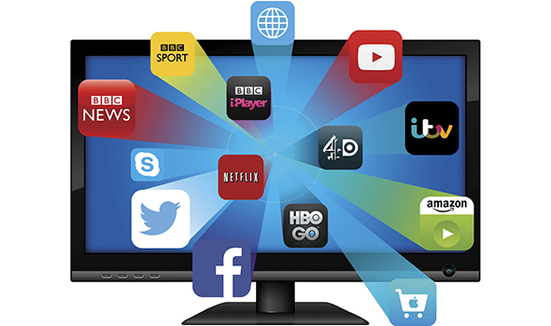
Next-generation TV
May 2017

Slide 2

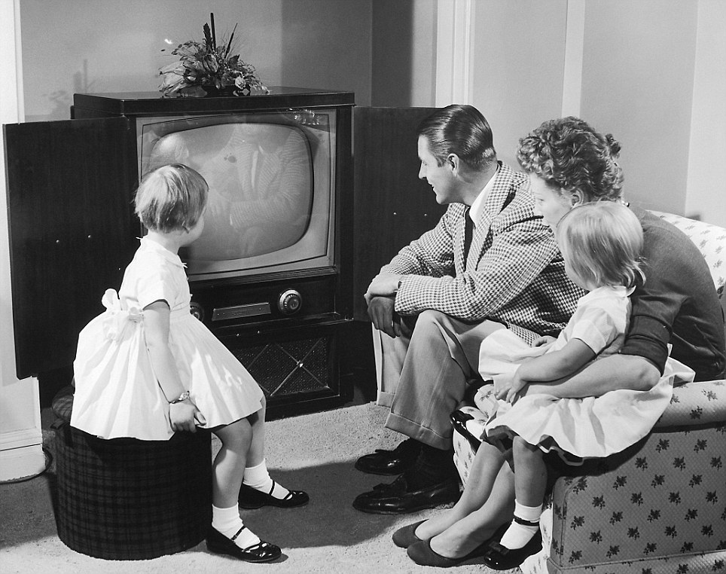

Slide 3
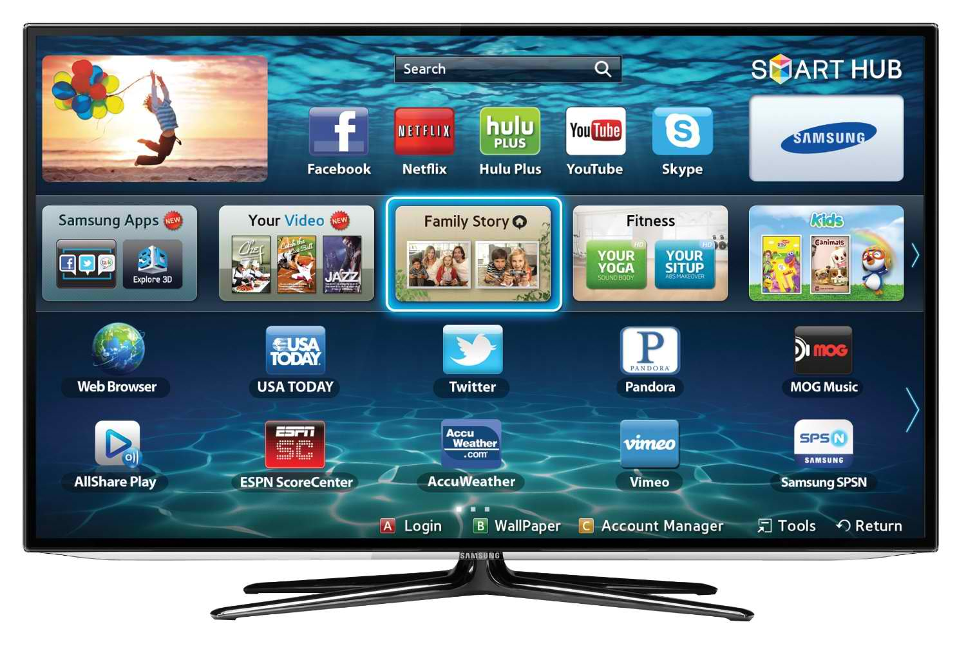
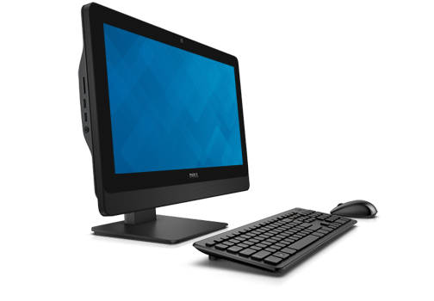
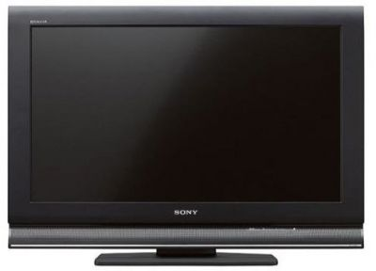

Slide 4
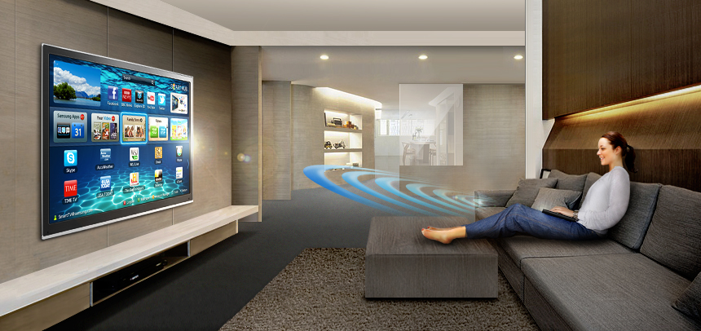

Slide 5
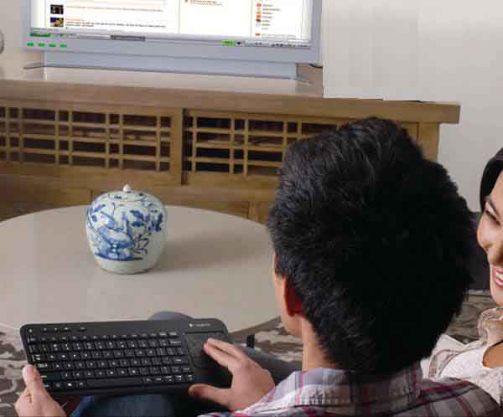

Slide 6
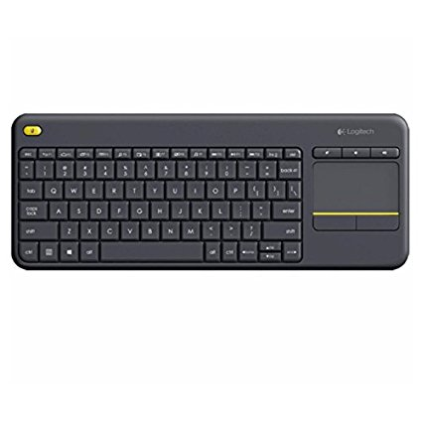
Bluetooth keyboard
with trackpad

Slide 7

Big Brother is watching YOU
Channels
Shows
Microphone
Camera

Slide 8
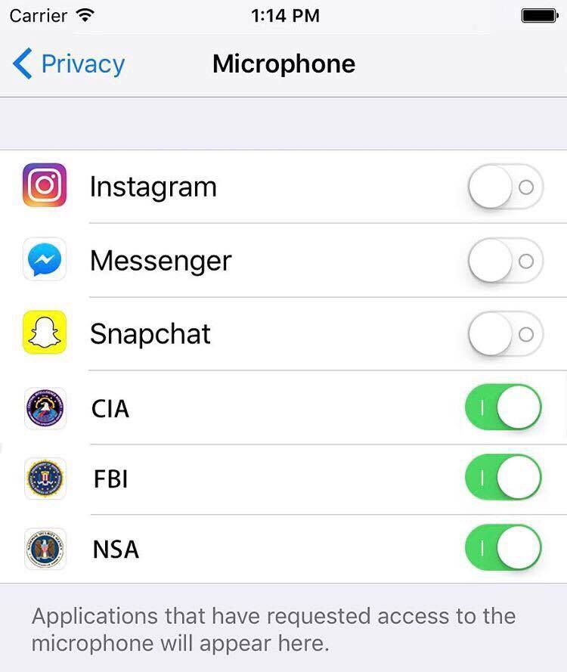

Slide 9
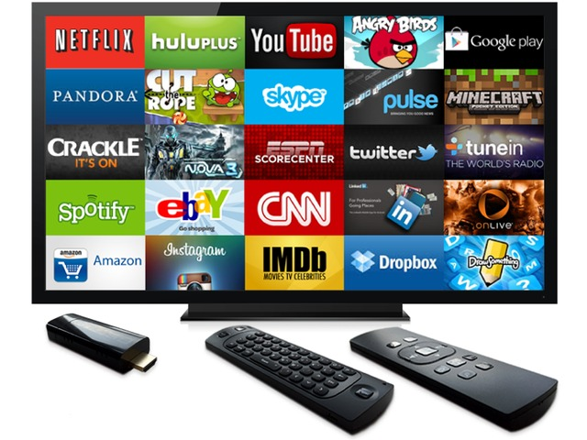
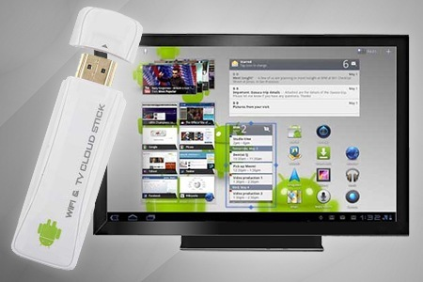
Smart TV
Dumb TV
with dongle

Slide 10
TV Operating systems
Android (2016 Sony, Phillips, some Sharp)
  Voice search using smartphone
Tizen (2016 Samsung)
Roku (2016 TCL, Hisense, Haier, some Sharp)
Firefox (2016 Panasonic)
WebOS (2016 LG, older Samsung)
Linux (some older Smart TVs)

Slide 11
Picture in picture (PIP)
4K resolution
3-D display (often curved)
Internet browser (Opera or Chrome)
ChromeBit (computer on a stick)
Streaming video (Roku, AppleTV, Chromecast, Amazon Fire TV)
Screen mirroring (Smartphone)
Smartphone as remote control
Show photos or videos
Full-featured computing

Slide 12
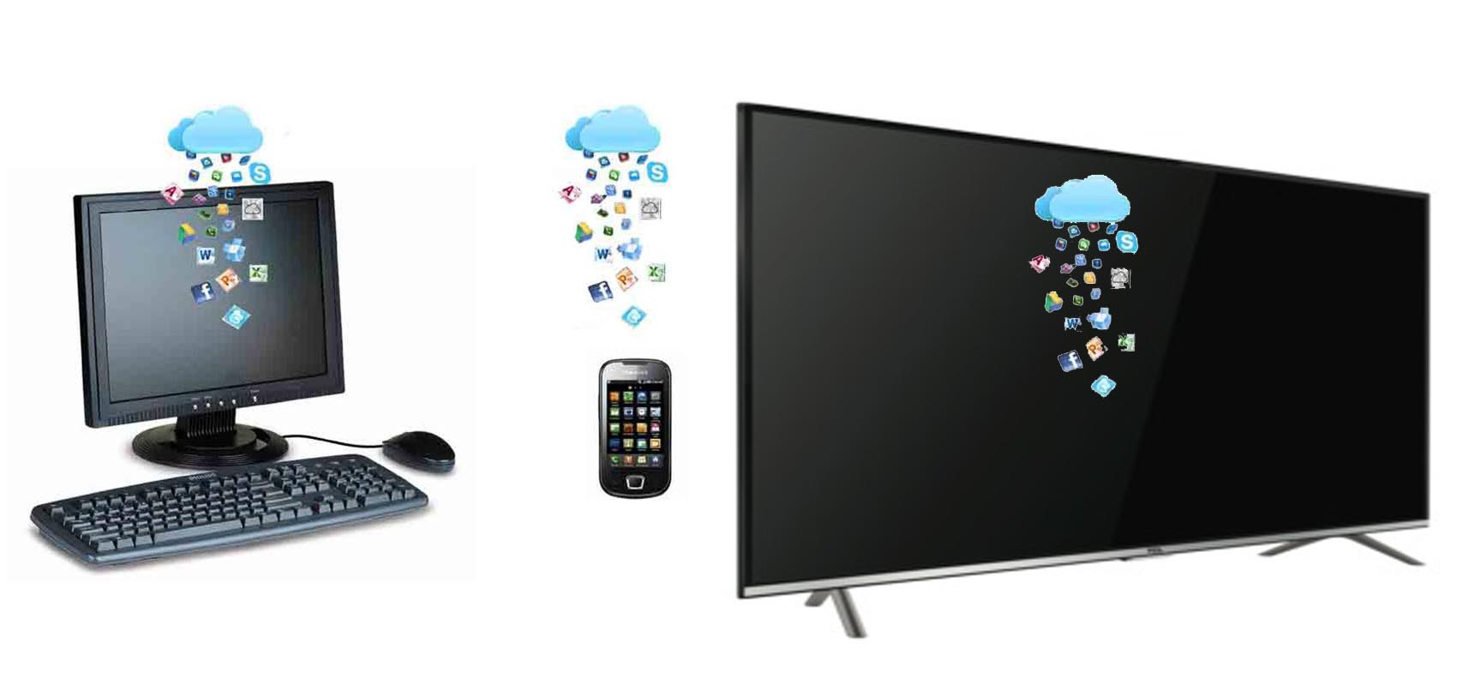

Slide 13


Slide 14
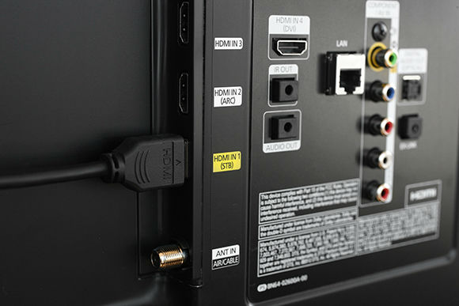

Slide 15
Connections
HDMI (dongles, DVD player)
  ARC=audio, STB=cable box, MHL=mobile device
USB (keyboard, mouse, play movies, view pictures)
3.5mm phono jack (traditional headphones)
Digital audio (modern headphones)
Infrared (IR) – interface to remote control
Bluetooth (no external connector)
Side connectors easier to access

Slide 16
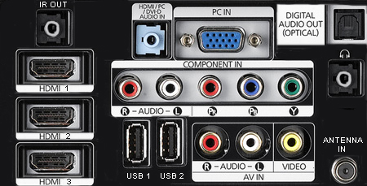

Slide 17
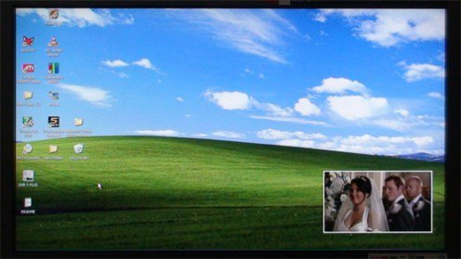
Picture in Picture

Slide 18
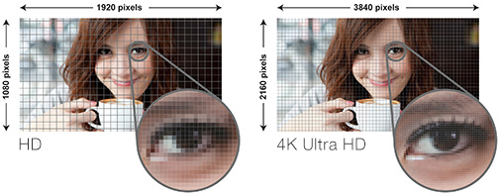
4K display
For more info visit http://4k.com/resolution

Slide 19
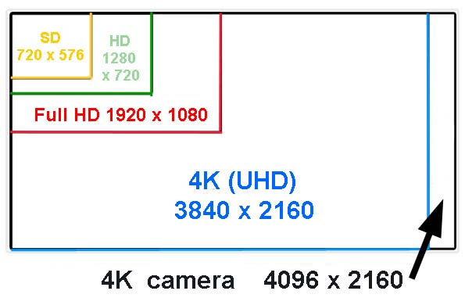

Slide 20
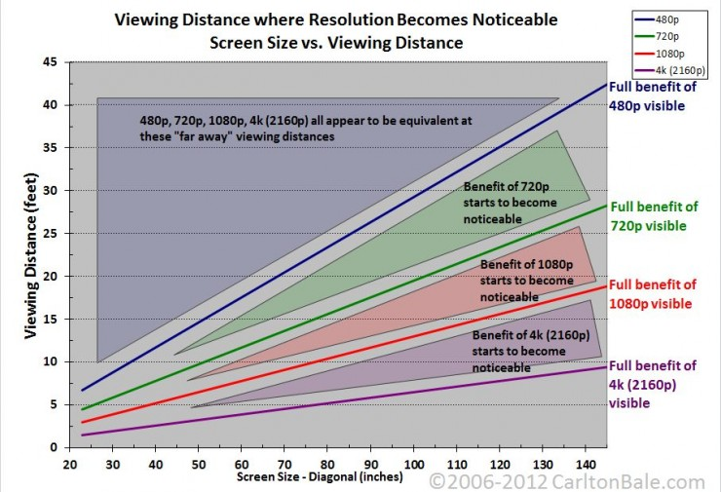

Slide 21
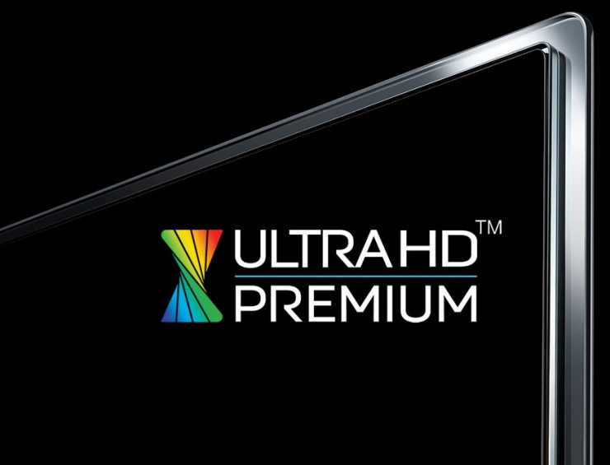
Superior color dynamic range
For more info visit http://4k.com/resolution

Slide 22
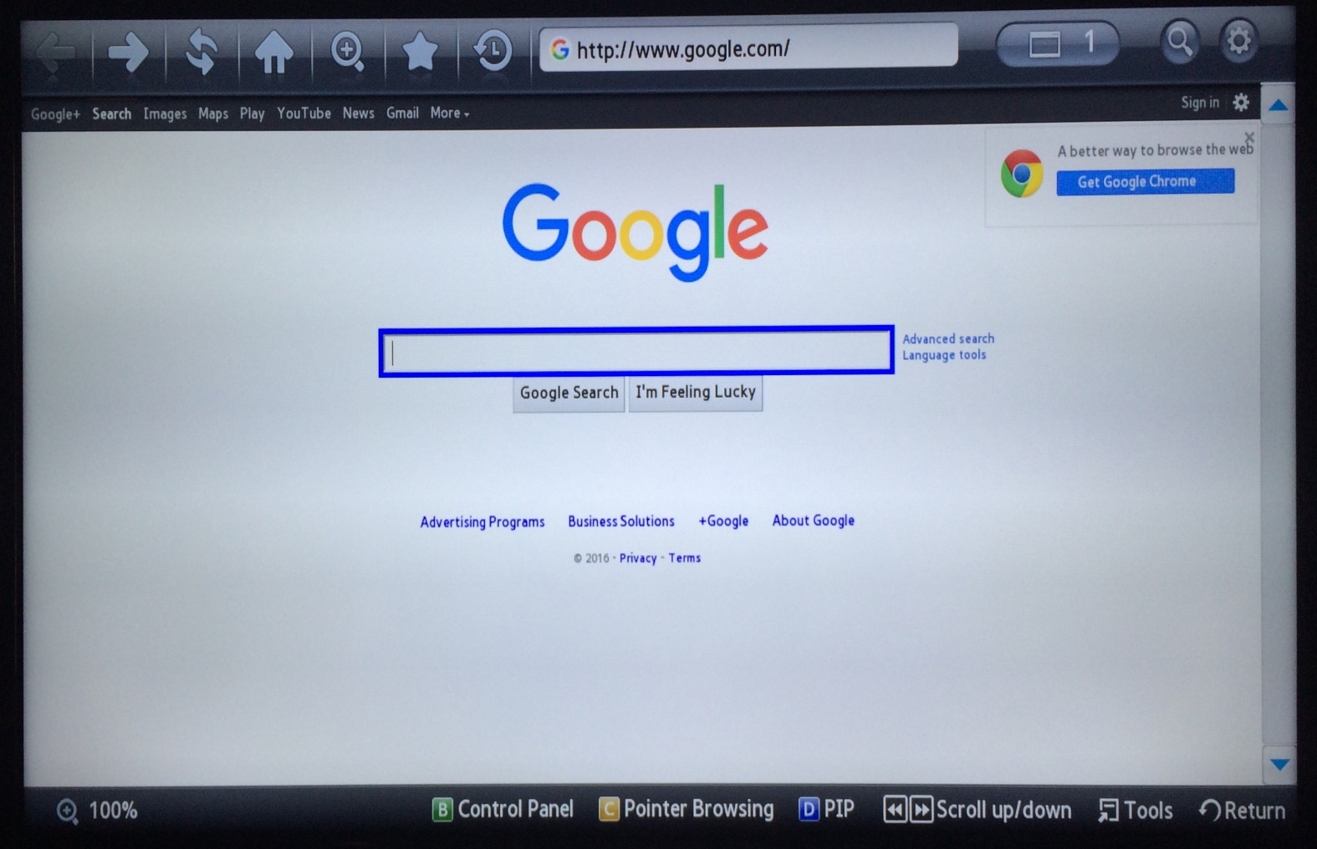
Internet browser
Opera
Chrome
Oddball

Slide 23
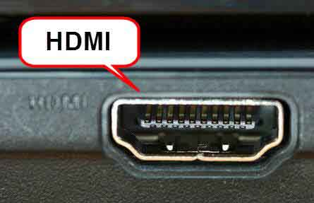
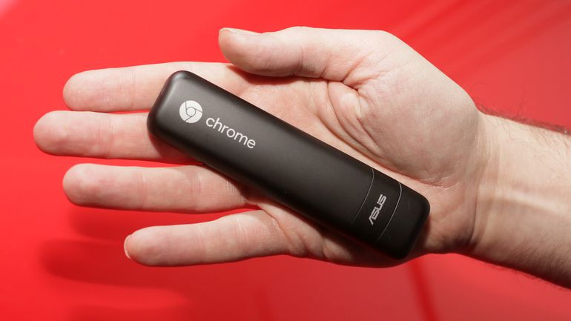
ChromeBit
Computer on a stick
Chrome OS
Android apps coming soon
$80 buys quad core, 2 GB of RAM
TV must have HDMI port

Slide 24
Set top box (streaming video)
Only for video – no browsing or email
Stream from cell phone or house WiFi
Netflix, Hulu, Amazon Prime, etc.
Roku
Google ChromeCast
Apple TV
Amazon Fire TV
www.techforluddites.com/streaming-media-players-comparison-chart/

Slide 25

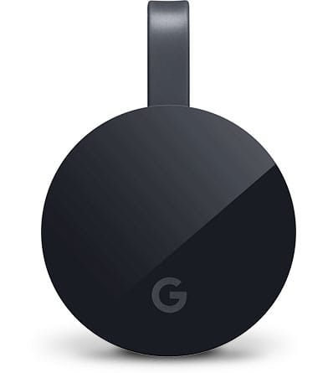
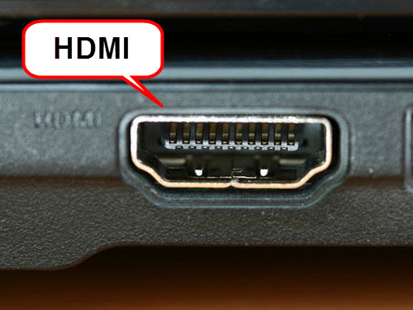
Stream video on old TV
Device costs $70
TV must have HDMI port

Slide 26

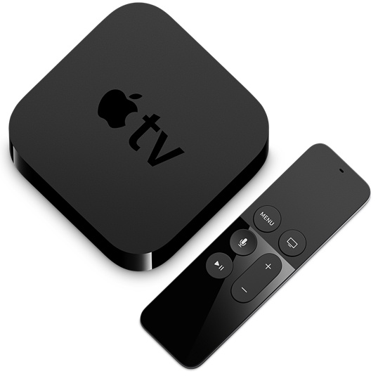
Stream video on old TV
Device costs $200
TV must have HDMI port

Slide 27
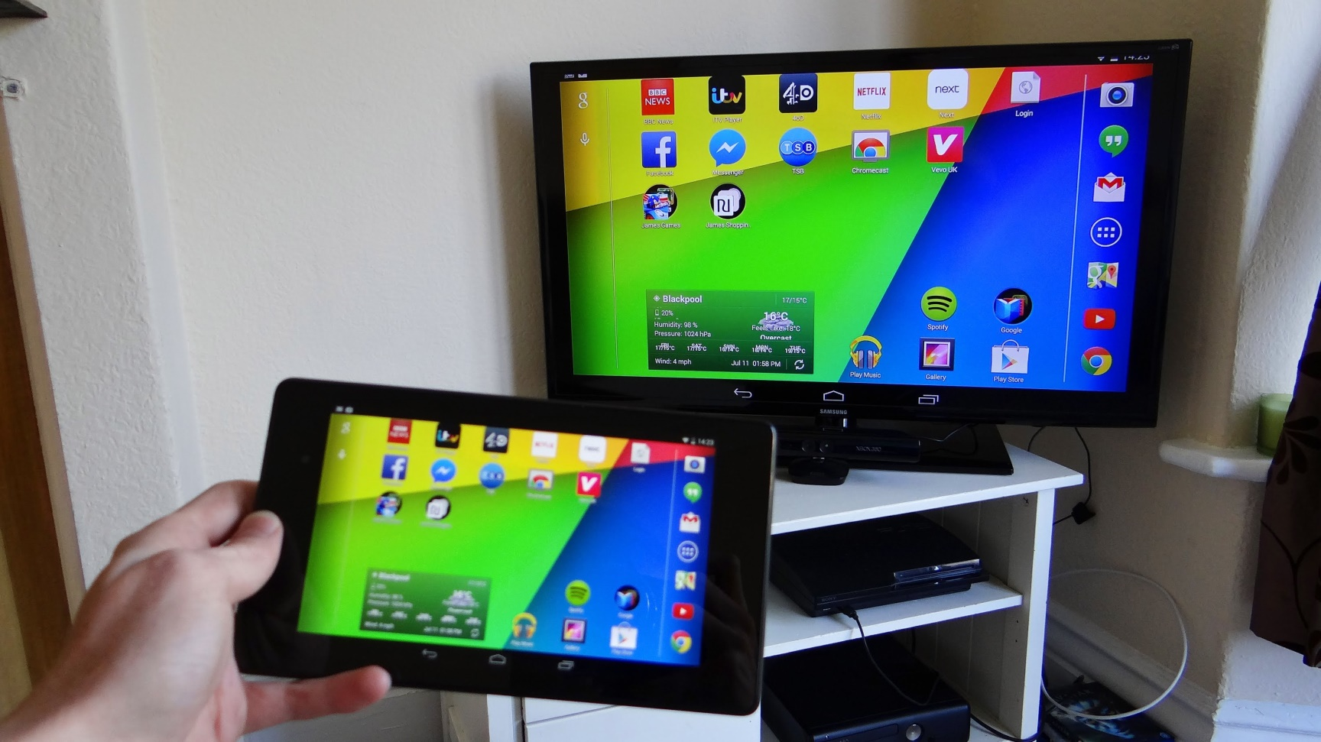
Screen mirror
Display smart phone or tablet on TV
Uses Wifi connection

Slide 28
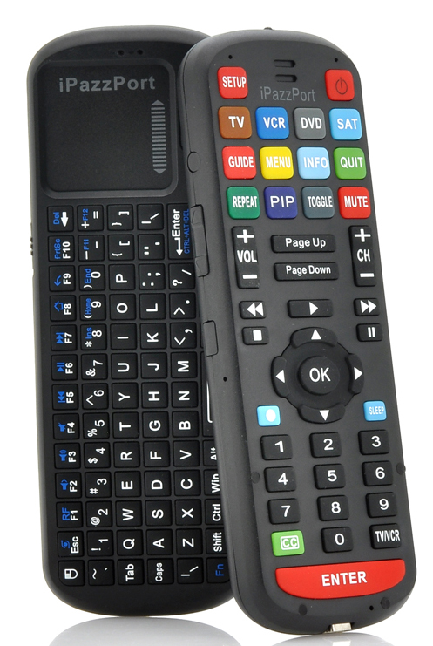
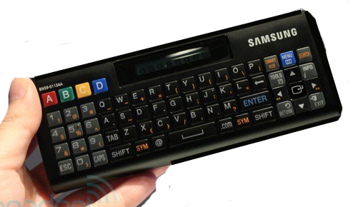
Remote controls
Confusing and hard to use

Slide 29
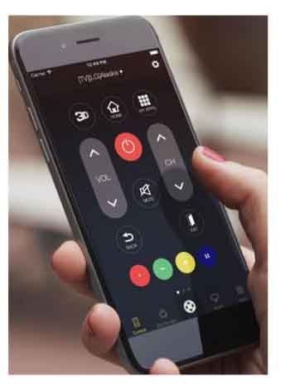
Smartphone as TV remote
Most TVs need a
smartphone with
IR emitter
Some TVs can be
controlled via Bluetooth

Slide 30
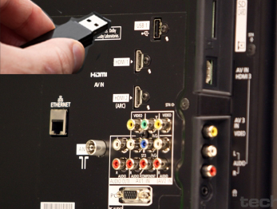
Show photos or videos
From TV USB port
Flash drive or portable hard drive

Slide 31

Full-featured computing
Not yet

