Slide 1


Slide 2
Windows 10
Ready for prime time
Final version of Windows
Free upgrade until July 29, 2016
New features
Works on most computers < 6 years old

Slide 3
Installation type
Pre-installed on new computer
  Recommend local account, not Microsoft login
Upgrade from Windows 7 or 8
  Keep settings, applications and most customizations
Clean install
  From Windows XP
  Lose settings and applications

Slide 4
Why upgrade?
Boots much faster
Only free until July 29, 2016
Security
New features
  Cortana (Similar to Siri)
  Multimedia
  Detect new hardware much faster
Forward compatibility
Simplified backup and recovery

Slide 5
Potential pitfalls
Wear and tear on computer
Old computer
PS/2 (round plug) mouse or keyboard
Old scanner or camera
Old software (Quicken, QuickBooks, AutoCAD)
Damaged hard drive will get worse
Possible loss of data
Downtime due to upgrades

Slide 6
More pitfalls
Slow internet connection
  Can install Windows 10 from disk downloaded on machine with fast internet
Laptop with weak battery
  Plug in to electricity while upgrading
  Designate WiFi as metered connection
  Printer with parallel port only
    – May need to purchase parallel-to-USB adapter
No longer able to boot directly to Safe Mode
  Use BCDEDIT to enable Safe Mode on boot

Slide 7

Avoiding the upgrade
Don’t want to upgrade?
Don’t want the Windows 10 nag screen?
Edit the registry to disable GWX and disable OS upgrade

Slide 8
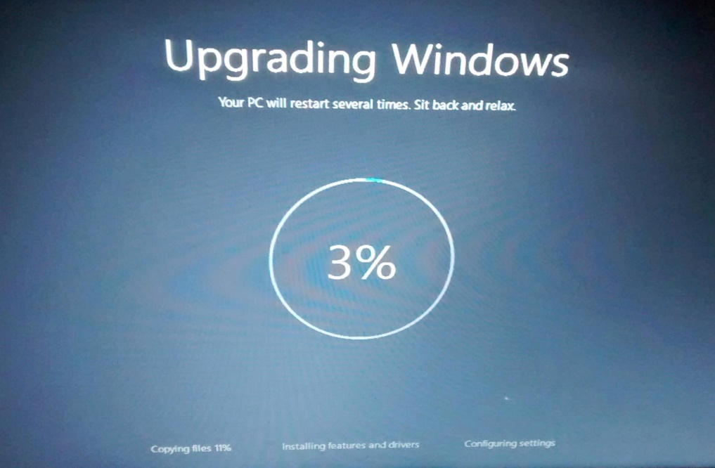
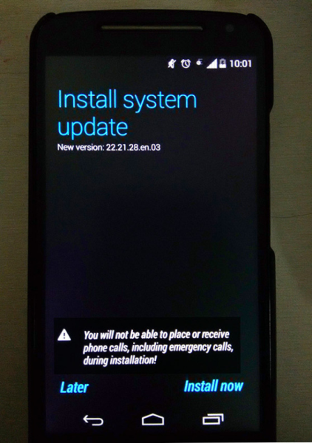
Service pack upgrade
Major upgrades twice a year
Can be postponed but not avoided
Compute is unusable for 2-3 hours
No notification or warning

Slide 9
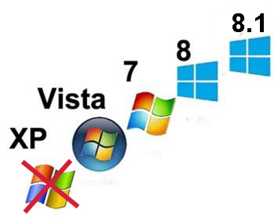
Ease of upgrade
No special knowledge needed
Takes about 2-4 hours for typical machine

Slide 10
Upgrade paths
32-bit to 32-bit
32-bit to 64-bit (requires clean install)
64-bit to 64-bit
64-bit to 32-bit (requires clean install)

Slide 11
Upgrade paths
Windows Home → Windows 10
Windows Starter → Windows 10
Windows Pro → Windows 10 Pro
Windows Ultimate → Windows 10 Pro
Windows Enterprise → no free upgrade
Windows volume license → no free upgrade

Slide 12
Can you upgrade?
Check compatibility with Microsoft Upgrade Assistant (just check, don’t use this to upgrade)
http://go.microsoft.com/fwlink/p/?LinkId=261871
Hardware compatibility
  CPU
  Graphics card
Software compatibility
  Quicken
  QuickBooks
  Other older programs

Slide 13
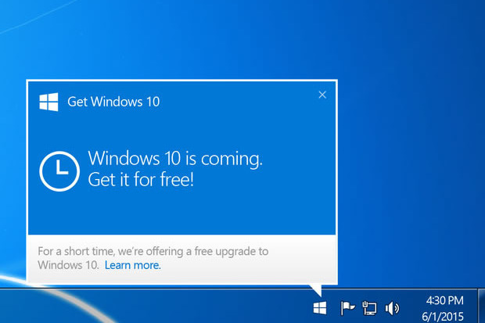
Upgrade nag screen

Slide 14
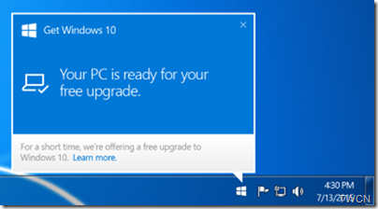
Upgrade nag screen

Slide 15

Before you upgrade
Back up data
Check hard drive for errors
Check for viruses
Do a system backup

Slide 16
After you upgrade
Make Windows 10 repair CD or flash drive
Install start menu software
Turn off lock screen
Add icon for Show Desktop
Plug security holes
Check that printer is default and it works
Perform full system backup
Turn off OneDrive
Install games (Solitaire, etc.) if needed
Fix sharing settings and browser add-ons

Slide 17
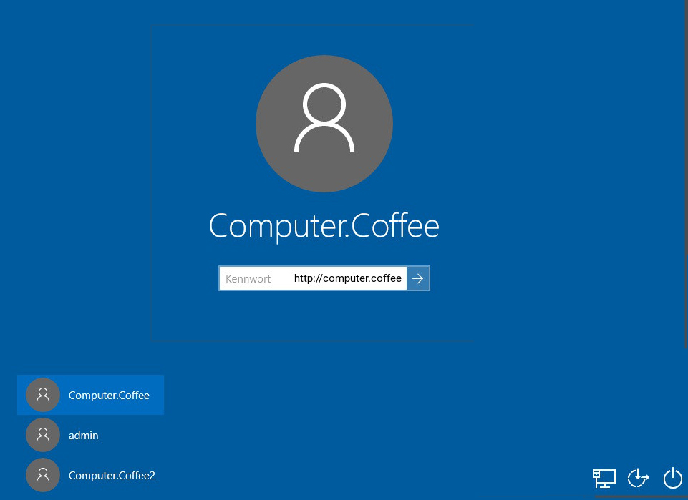
Log in screen

Slide 18
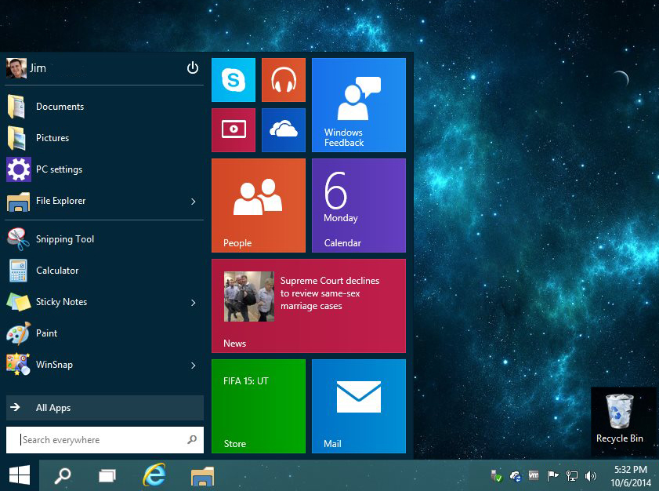

Slide 19
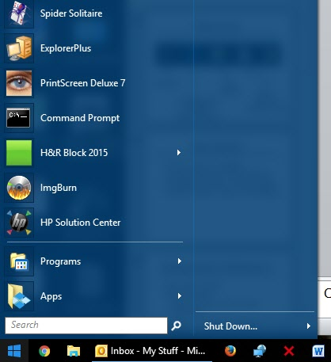
Apps vs. Applications
Apps run on phones, tablets and computers
Applications are programs for computers
Applications are more complex

Slide 20

New icons
Task view
File
Explorer
Store -
Buy and
download apps
Microsoft Edge
replaces
Internet Explorer

Slide 21
New names
This PC (was My Computer)
Microsoft Edge (was Internet Explorer)
PC settings (Windows 10 control panel)
Windows update – moved to PC settings

Slide 22
Rolling back to Windows 7
Easy within 30 days
Harder after that
  Restore Windows 7 system image
  Clean install

Slide 23
Controlling Windows updates
On wired ethernet, cannot be disabled
Can be postponed for several months
  Not recommended
On WiFi, can designate as metered connection
  Manual update
  Recommended at least once a month

Slide 24
Windows 7 games
Manual install and download
Have to re-install after every service pack (build) upgrade, about twice a year

Slide 25
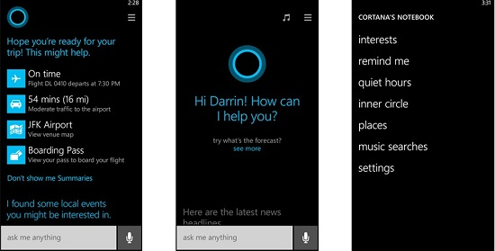
Cortana personal assistant

Slide 26
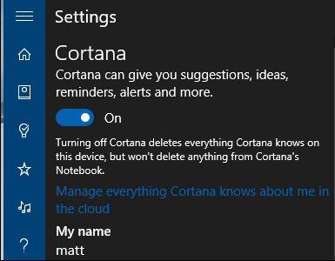
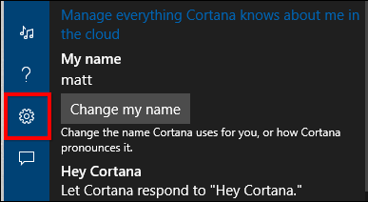
Cortana personal assistant

Slide 27
Enabling safe mode on boot
Safe Mode needed to recover from bad drivers, virus infestation, etc.
From elevated command prompt:
bcdedit /set {bootmgr} displaybootmenu yes
bcdedit /timeout 2
bcdedit /set {default} bootmenupolicy legacy

Slide 28
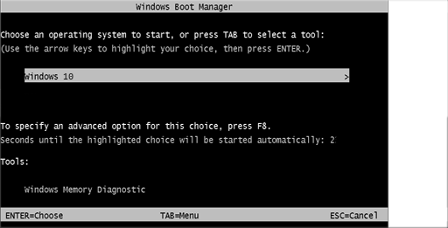
Enabling safe mode on boot
Hit F8 when you see this screen

Slide 29
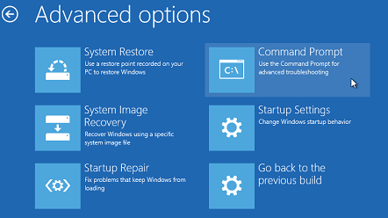
Recovery environment
Hold down shift key while restarting
If can’t boot, may launch automatically

Slide 30
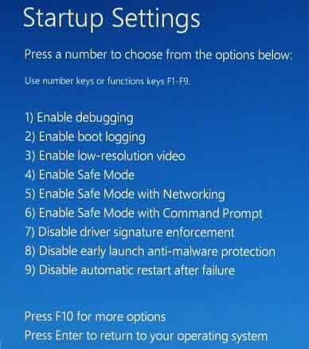

Slide 31
Windows 10 start menu customization

Slide 32
System image back up
Built-in software on Windows 7,8 and 10
Third-party software (Acronis)
Can mirror hard drives (RAID)
  For secondary backup only

Slide 33
Data back up
Cloud backup
  Google Drive
  DropBox
Local backup
  Manual drop-and-drag
  Third-party software (GFI)
  Built in software in Windows 7, 8, and 10
  Time Machine (NOT recommended)

Slide 34
Local or Microsoft login
Local login
  Easier to trouble-shoot and repair
  Can use blank password
Microsoft login
  Sync with OneDrive
  Sync with Live Mail and Outlook.com
  Can get locked out of computer
  Harder to trouble-shoot
  Cannot use blank password

Slide 35
To learn more
My website
www.suekayton.com
click on Windows 10 update
Tom’s Guide to Windows 10
http://www.laptopmag.com/t/windows

